Slide 1
How can a small scale prototype be built?
The prototype should arguably be energised by the following:
Utilisation of waste gases from industrial processes, particularly those containing high water vapour content
Injection of high velocity gases into a vortex chamber
This would facilitate demonstration of the principle of the updraft vortex, while eliminating the need for a relatively expensive heat exchange system.

Slide 2
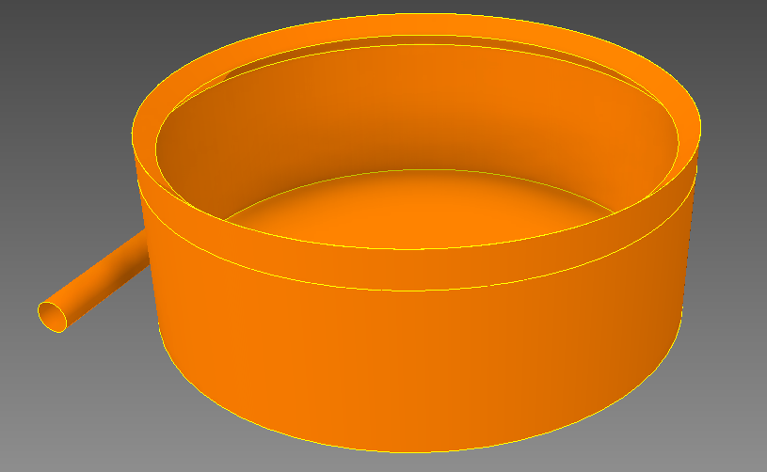
Sketch of 20 metre prototype

Slide 3
Sketch of 20 metre prototype
Injection nozzle
Sketch
φ 20 m.
9.2 m. centres.
X
Vortex chamber height ~ 7m.

Slide 4
Proposed Exemplar
A particular waste gas on the downstream side of a wet scrubber in an extractive metallurgical plant in the writer’s experience had the following characteristics:
Temperature 82ºC
Water vapour content 22%
CO₂ 10%
Exit velocity from induced draft fan 40 m/s
Exit velocity from injection nozzle 100 m/s
Approximate volumetric flow rate at NTP 40 m³/s
Approximate energy flux 25 MW
Gas stream fluid power 500 kW
This would be ideal for use as feedstock for a 20 metre diameter vortex engine prototype.
The prototype demonstrator would have a low efficiency due to the relatively low plume height, but assuming a conservative one kilometre high plume, a notional output from the rig could be in the region of one megawatt.
The prototype would primarily be useful to demonstrate the feasibility of dispersal of waste gases from process and power plant stacks with power generation as a bonus.

Slide 5
Prototype projected cost
The cost of such a prototype including instrumentation would vary considerably with the location in which it was built.
A rough estimate for China would be in the region of around US$1 million dollars, assuming that the heat input for, say, a year’s research comes free of charge in the form of waste vapour and gas, and that the fan is available from existing plant.

Slide 6
“…What’s necessary at this point is to do proofs of concept,” says professor Kerry Emanuel, the hurricane expert at MIT. “Michaud’s idea is pretty simple and elegant. My own feeling is that we ought to be pouring money into all kinds of alternative energy research. There’s almost nothing to lose in trying this...”
ODE Magazine, March 2008

