Slide 1
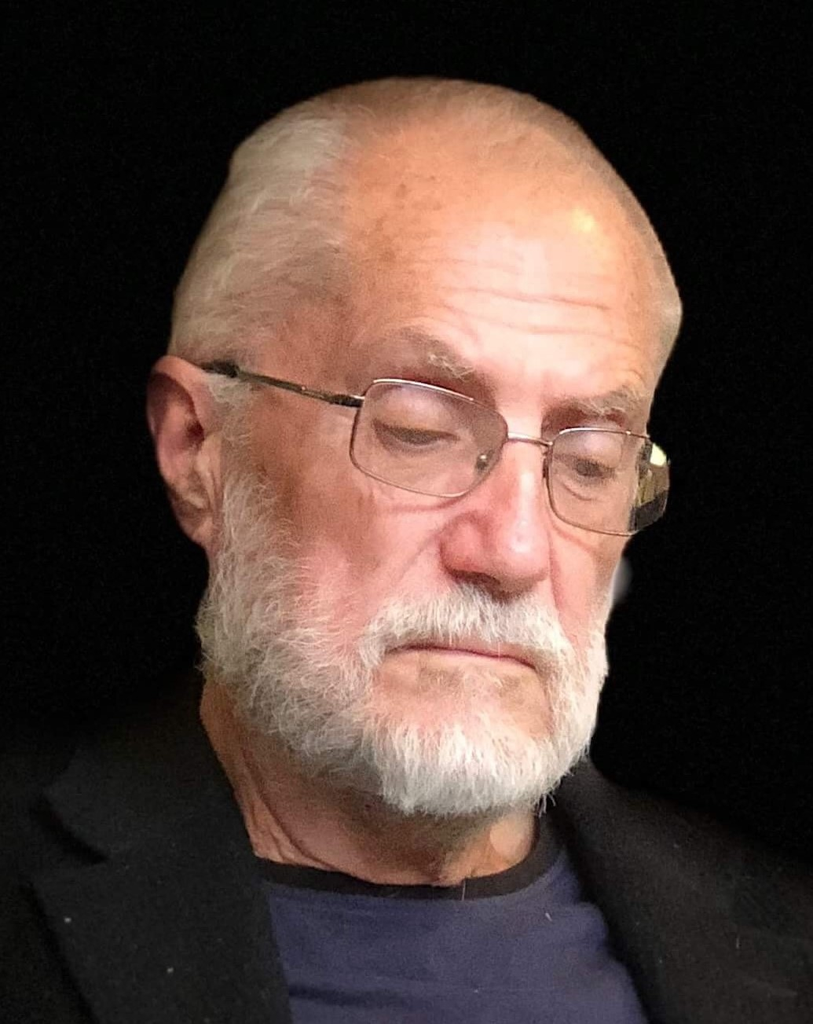
COMPUTATIONAL FLUID DYNAMICS MODELLING OF VORTEX ENGINE RESEARCH PROTOTYPE
INVESTOR PRESENTATION
VORTEXENGINEER
THE ATMOSPHERIC VORTEX ENGINE
February 2023
Founder: Donald Cooper

Slide 2
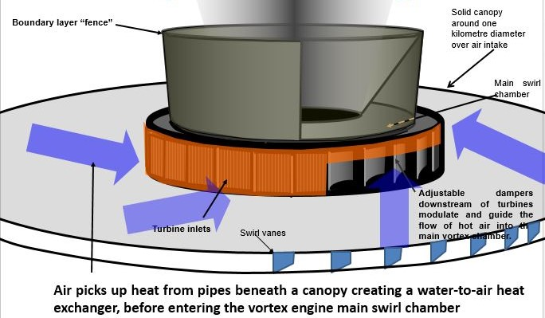
INTRODUCTION
Figure 1.
Diagrammatic view showing the favoured geothermal-powered system
The vortex engine is designed to create enhanced atmospheric convection for:
  Improvement of heat transfer from Earth to Space within the atmosphere
  Generation of an electrical power output
  Enhancing local rainfall

Slide 3
BACKGROUND (1)
The concept of a vortex engine or atmospheric vortex engine (AVE), independently proposed by Norman Louat (Australia) and Louis M. Michaud (Canada), aims to generate a large buoyant vortex of air, reaching as close to possible to the top of the Troposphere (ca 10 km). The AVE induces ground-level vorticity, resulting in a vortex similar to a naturally occurring “land-spout” or “water-spout.”
The purpose of the first prototype stage of the R&D project is to prove the principle by means of computational fluid dynamics (CFD) modelling. The purpose of the later physical research stages would be to eventually commercialise the system.
The Vortex Engine system is a revolutionary technology, converting low grade waste heat into clean electricity by generating and harnessing the power of an atmospheric vortex.

Slide 4
BACKGROUND (2)
It is intended to use the principle of the AVE to develop and market the technology for:
  Sustainable generation of electrical power for the Grid or local usage
  Transmission of waste heat from Earth’s surface to the top of the Troposphere and hence to Space
  Significant enhancement of precipitation in the system’s locality
  Scrubbing pollutants from the Atmosphere
  Preventing irreversible damage to the global environment.
  Utilisation of global low-grade energy resources.
  Approximately 50% of the world’s total energy consumption is lost as waste low-grade heat. This is enough to power more than three billion households, or an amount equal to that which the US, China, and India, currently consume annually.

Slide 5
SOURCES OF PRIMARY ENERGY
Other specific sources of low-grade or waste heat could be:
Process industry waste flue gases.
Process industry “wet scrubber” exit gas.
Solar energy.
Waste flare gas from the petroleum Industry.
It is argued that the short-term use of waste energy from gas flaring, which is a core part of this project strategy, will allow fast-tracking of the proposed research and development program. The use of waste flare gas is pragmatically preferred as a cost-effective energy source for the research rig, but this would be reviewed within the design analysis process.

Slide 6
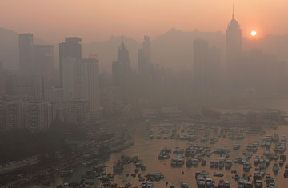
Earth’s moist convection is currently being inhibited by the action of the ATMOSPHERIC BROWN CLOUD. These clouds act to reduce the atmospheric temperature at ground level and increase it towards the middle of the troposphere. This has the overall effect of reducing the temperature gradient and hence the atmospheric convective energy.
In addition:
“…dimming by [Atmospheric Brown Clouds - ABC] suppressed the sea surface temperatures in the North Indian Ocean from responding to the greenhouse warming; whereas, south of the equator (where the brown cloud effects are minimal) the sea surface warmed by as much as 0.7 K since the 1950s. The net effect is a reduction in the north–south sea surface temperature gradient which in turn led to a deceleration of the monsoon circulation…”
https://www.pnas.org/doi/10.1073/pnas.0500656102
Application of AVEs can act to enhance the monsoons and improve their reliability.

Slide 7
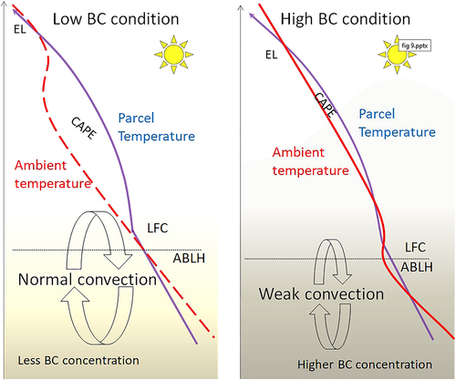
BLACK CARBON (BROWN CLOUD) AND CONVECTION INHIBITION
BC = brown cloud
CAPE = convective available potential energy

Slide 8
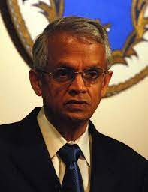
VEERABHADRAN RAMANATHAN AND THE ATMOSPHERIC BROWN CLOUD
“…We also show that greenhouse gases and sulfates, by themselves, do not account for the magnitude or even the sign in many instances, of the observed trends. Thus, our simulations suggest that absorbing aerosols in atmospheric brown clouds may have played a major role in the observed regional climate and hydrological cycle changes and have masked as much as 50% of the surface warming due to the global increase in greenhouse gases. The simulations also raise the possibility that, if current trends in emissions continue, the subcontinent may experience a doubling of the drought frequency in the coming decades…”
https://www.pnas.org/doi/10.1073/pnas.0500656102

Slide 9
THE “ANTI-BROWN CLOUD PROJECT”
Convection processes such as storms, cyclones and tornados are the primary means of effectively pumping heat out of the ocean, into the atmosphere, and lifting it to where it can be re-radiated into space, thereby mitigating the heat build-up that would otherwise occur.
The Atmospheric Vortex Engine is the only method available for enhancing the convection process.
Convection within the troposphere is critical in order to prevent global warming
Convection is currently significantly inhibited by several atmospheric mechanisms including
  Inversion layers
  Atmospheric brown clouds
Waste flare gas is pragmatically the most effective energy source to begin with in utilizing the AVE for enhancing atmospheric convection

Slide 10
THE VORTEX ENGINE PROJECT

Slide 11
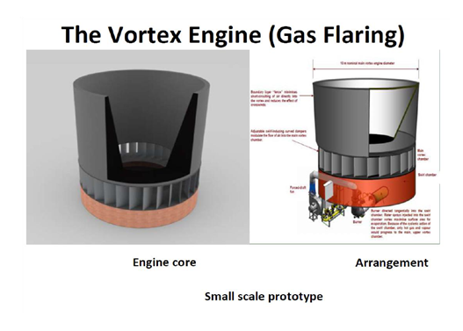
The first stage of a proposed research project is to design and build a small-scale prototype. In order to finance this, it is proposed to:
Build a Computational Fluid Dynamic model based on the use of waste flare gas
Use the output of the modelling exercise to allow design of the research prototype
A satisfactory CFD model outcome would then aim to eventually lead to self-funding R&D for achieving an industrial-sized power plant.
The prototype rig CFD modelling (stage 1) cost which is the subject of this funding request will be $100,000.
Figure 2
Diagrammatic view of notional research prototype.

Slide 12
The Vortex Engine system is a revolutionary technology, converting low grade waste heat into clean electricity by generating and harnessing the power of an atmospheric vortex.
We have competitors, including, at least:
      New Zealand (Vortex Power Systems: The University of Auckland)
      The USA (The Georgia Institute of Technology jointly with Oak Ridge National Laboratory)
      Croatia (The University of Split)
      Malaysia (The Universiti Teknologi PETRONAS – wholly-owned by Petronas
      Canada (The University of Western Ontario)
Arguably, none of the above is currently past the relatively small-scale research rig stage. Vortex Power Systems are currently seeking $5 million funding for a one MWe rated research prototype.

Slide 13
  THE GLOBAL RENEWABLE ENERGY MARKET
MENA = Middle East North Africa
ROW = Rest of World

Slide 14
AVE COMPETITIVE ADVANTAGES
Comparison of advantages of Wind, Solar and Atmospheric Vortex Engine based on 500 MW plant capacity:
 | Wind | Solar | Atmospheric Vortex Engine
Estimated site area | 7000 hectares | 3500 hectares | 400 hectares
Installed cost for 500 MW in China / India | $750 million * | $400 million * | ~ $500 million +
Working life (years) | 20 | 25 | 50 - 80
Generates power 24/7 | No | No | Yes
Predictable output | No | No | Yes
*based on figures from https://w3.windfair.net/wind-energy/news/18208-product-of-the-week-wow-what-power-the-solar-wind-energy-tower
+ based on a personal estimate.

Slide 15
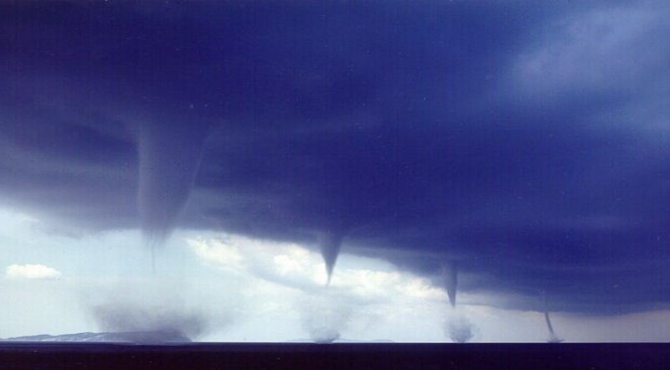
Figure 3 A natural vortex array off the coast of Greece.

Slide 16
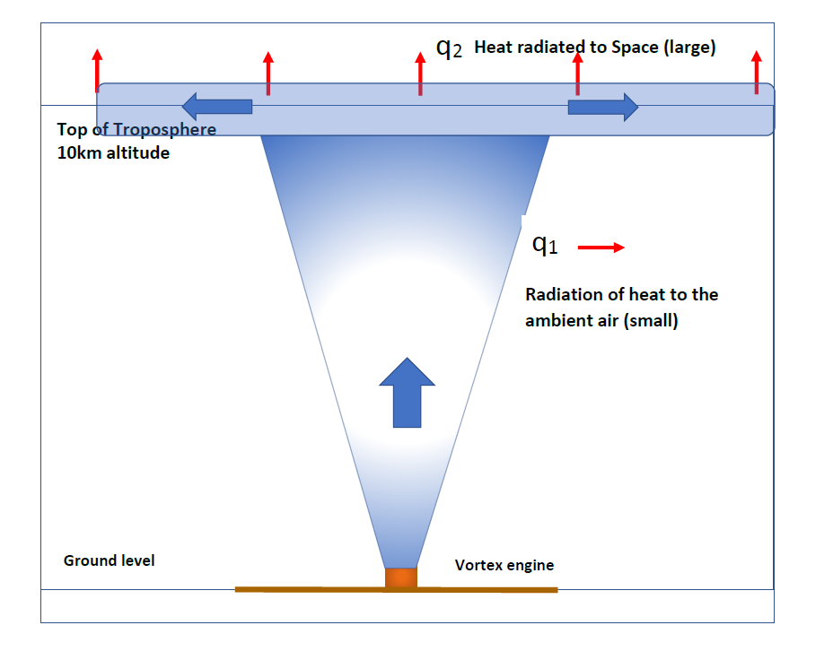
Figure 4
Vortex relative heat transfer

Slide 17
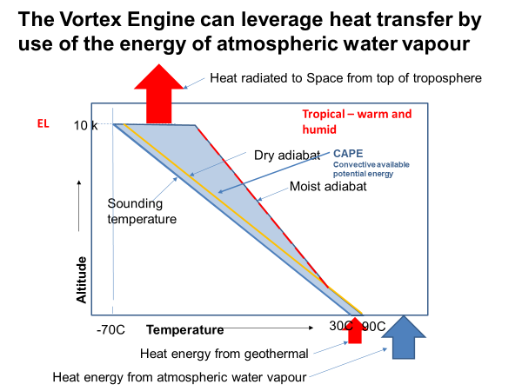
Figure 5

Slide 18
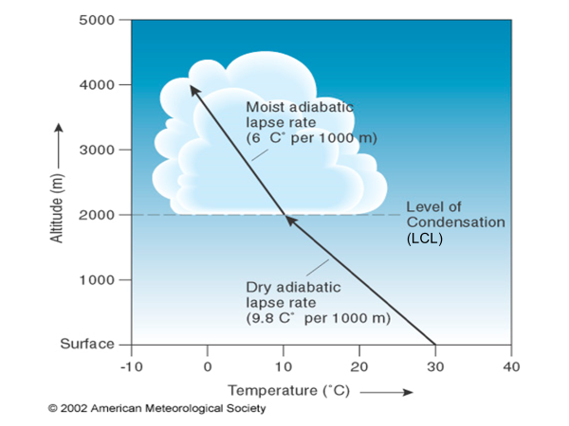
THE VALUE OF WATER VAPOUR IN ENERGISING THE BUOYANT UPDRAFT
The latent heat of water vapour is essentially “stored solar energy.” A very large amount (around 3.5 Gigajoule) is liberated in going from water vapour at 30C to one cubic metre of ice at -70C. Although atmospheric air has relatively modest vapour content, it is almost like gasoline: ten kilogram of water vapour is equal to the energy content of one kilogram of fuel oil:
Figure 6
The gain in temperature with a “moist adiabatic lapse rate.”

Slide 19
THE POWER OF THE VORTEX UPDRAFT TO PENETRATE EARTH’S CONVECTIVE INHIBITION LAYER
“Funnel” of visible rising water vapour and warm air
Air at altitude rotates with the vortex and cannot enter the cone of the vortex eye.
On the other hand, less dense water vapour content is preferentially displaced towards the eye by the centrifugal field
Figure 7
Moist air within the stagnant boundary layer is able to move towards the low pressure “eye” due to the relative lack of centrifugal force
The vortex mechanism inherently minimizes entrainment between the highly buoyant updraft stream and the surrounding atmosphere

Slide 20
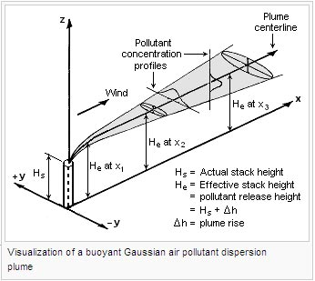
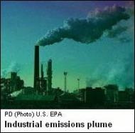
ON THE OTHER HAND, A NON-ROTATING PLUME HAS AN INHERENTLY HIGH LEVEL OF ENTRAINMENT:
Figure 8
The temperature differential involved is much higher than the waterspouts, but entrainment of the surrounding air severely inhibits convection

Slide 21
WHAT THIS MEANS
reflection to Space
-70ºC
tropopause
Figure 9
evaporation
precipitation
=> Higher tropospheric humidity
=> Lower tropospheric humidity
convection
earth
Non-rotating updrafts lead to global warming.
Rotating updrafts reduce global warming.

Slide 22
  BUSINESS CASE OBJECTIVES
The main medium-term objective for the project is to demonstrate the viability of increasing the convective heat transfer from waste heat such as natural gas flares or low-grade geothermal energy.
The main objectives of this first stage of the research project would be to:
Prove the fluid dynamics and thermodynamics theory behind the vortex engine principle.
Compile data to allow optimization of the design of the first-stage research rig.
From the first two items above, put together a technical presentation for Industry to enable the venture partners to make an informed decision regarding funding of larger-scale research rigs.

Slide 23
  BENEFITS TO BE DELIVERED TO THE PROSPECTIVE PROPONENTS IN STAGE 1
A mechanical engineering Consultant with expertise in fluid mechanics and thermodynamics will develop the CFD and a conceptual thermal-hydraulic design for the prototype Atmospheric Vortex Engine. The primary focus is the configuration and sizing of a commercial AVE for vortex generation, with or without power generation i.e., for precipitation generation. This conceptual design will be the basis for the AVE Pilot Plant Project. A further goal of the conceptual design is to provide a basis for the development of appropriate information content for the possible filing of patents.
If the outcome of the project CFD and Design Conceptualisation is successful it will lead on to the development of a renewable energy system which is likely to have very significant advantages over existing PV and wind systems.

Slide 24
KEY PERFORMANCE INDICATORS FOR THE CFD INVESTIGATION
The KPIs for the CFD modelling would be:
  The measurement, optimization and analysis of system parameters, both internally controlled and external (e.g. crosswinds and inversion layers).
  The application of these CFD data to facilitate the design of the prototype research rig for the next stage of the Project.

Slide 25
FINANCIALS (1)
The purpose of this first project stage, with a budget cost of $100,000, is to prove, using Computational Fluid Dynamics (CFD) modelling, the principle of:
Waste flare gas utilisation.
General AVE operation,
and to develop a prototype design to take forward for the purpose of further research and development.
The purpose of the later physical research stages would be to eventually commercialise the system utilising sources such as:
Low-grade geothermal energy.
Solar energy.
Waste heat from Process plant.

Slide 26
FINANCIALS (2)
The concept on which the Vortex Engine is based was initiated by the French engineer Edgard Nazare in about 1940. Because patents expired around 60 years ago, no one currently holds any intellectual property. It is expected that, like the Whittle jet engine in 1940, IP will be generated from the ongoing research and development program.
The benefits to the CFD venture financier from the funding of the CFD investigation would be:
In conjunction with the Proponent, EXCLUSIVE and CONFIDENTIAL access to the Consultant’s CFD report and
“Right of First Refusal” for the subsequent possible formation of a Joint Venture company to carry out the ongoing Project.

Slide 27
STAKEHOLDERS
In terms of benefits of the vortex engine concept, the Stakeholders in the Project arguably include the whole planet.
As mentioned, there is currently no intellectual property held by anyone in relation to this proposal.
The basic concept entered the public domain about seventy years ago with the patents of the French engineer Edgard Nazare. The New Zealand Vortex Power Systems company claims to have taken out patents on one or more details of their research rig. Other such entities with historical claims are detailed in:
https://patents.google.com/patent/WO2003025395B1/nl

Slide 28
  BUSINESS CASE OBJECTIVES
The main medium-term objective for the project is to demonstrate the viability of increasing the convective heat transfer from waste heat such as natural gas flares or low-grade geothermal energy.
The main objectives of this first stage of the research project would be to:
Confirm the fluid dynamics and thermodynamics theory behind the vortex engine principle.
Compile data to allow optimization of the design of the first-stage research rig.
From the first two items above, put together a technical presentation for Industry to enable venture partners to make an informed decision regarding funding of larger-scale research rigs.

Slide 29
Figure 10

Slide 30
Will vortices work?
‘…Nilton Renno, a professor at the department of atmospheric, ocean and space sciences at the University of Michigan, has spent his career studying tornadoes and water spouts. He says there is no reason why [the] vortex engine wouldn’t work.’
…"The amount of energy involved is huge. Once it gets going, it may be too hard to stop," he says.
The Toronto Star, July 21 2007
“…‘The science is solid,’… ‘Once you induce circulation nearby, the vortex can be self-sustaining.’ ”
Discovery, Feb 28 2013
“…What’s necessary at this point is to do proofs of concept,” says professor Kerry Emanuel, the hurricane expert at MIT. “[The] idea is pretty simple and elegant. My own feeling is that we ought to be pouring money into all kinds of alternative energy research. There’s almost nothing to lose in trying this...”
ODE Magazine, March 2008

Slide 31
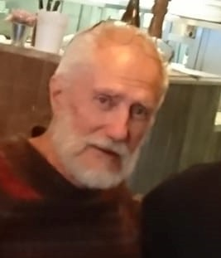
FOUNDING PROPONENT
Donald Cooper is a professional mechanical engineer and inventor strongly interested in alternative energy and the implications of climate change.
See his LinkedIn profile at: https://au.linkedin.com/pub/donald-cooper/17/7ab/638

