Slide 1
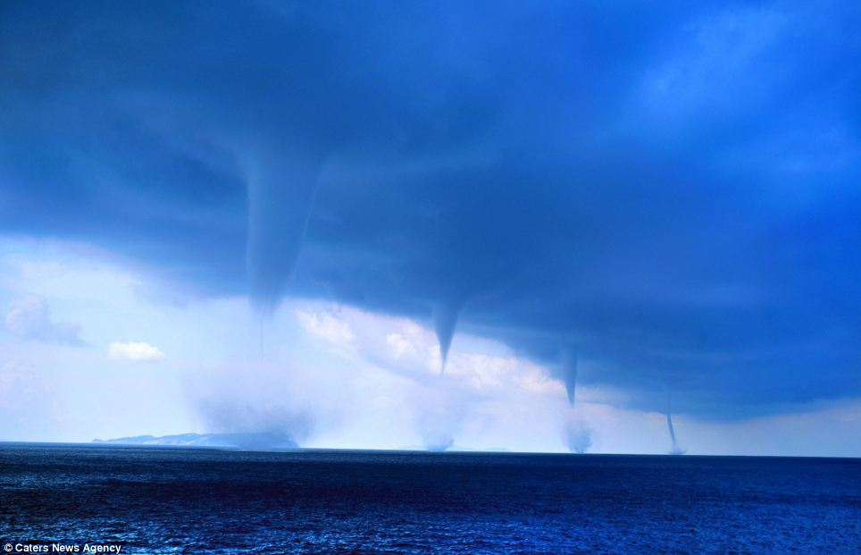
Buoyancy-Induced Columnar Vortices for Power Generation
A proposal for the utilization of updraft systems to sustainably generate electrical power, reduce global warming and increase localised rainfall
Presentation by
Donald Cooper MIEAust
Photo: University of Wisconsin - Milwaukee

Slide 2
Roberto Giudici
Infrared radiation to Space
Incoming solar radiation
Convection
Water vapour and warm air

Slide 3
Seeing just one waterspout is thought by many to be a once-in-a-lifetime event, but one lucky boat passenger managed to capture four in these amazing pictures.
Italian Roberto Giudici managed to take the pictures while sailing off the Greek Island of Orthoni, in the Ionian Sea, when a huge storm blew up over night.
The morning light then revealed this stunning scene of the four waterspouts, which develop in a similar way to tornadoes but are usually weaker.

Slide 4
Background: Latent Heat in Atmospheric Water Vapour is Released Within a Buoyant Plume
The energy required to transform a tonne (roughly one cubic metre) of ice at minus 70ºC into vapour at 30ºC is around 3.5 Gigajoules.
Conversely, transforming a tonne of water vapour into ice between the same temperature range liberates this amount of energy into the environment.
This is comparable to the chemical energy contained in 100 litres of fuel oil. The notional “volumetric ratio” of water vapour to fuel oil is thus in the region of 10:1.
A rising atmospheric plume typically works between 30ºC at ground level to minus 70ºC at the top of the troposphere. As the water vapour condenses and eventually freezes, energy is released. This warms the surrounding air, resulting in an increase in the buoyancy and hence the corresponding potential energy of the air within the plume.
This buoyancy can be utilized to convey the air-water vapour mixture to higher altitude, and in some instances supply excess energy for the production of electrical power as a by-product.

Slide 5
The Energy Content of Atmospheric Water Vapour
It has been estimated that the Earth’s atmosphere holds in the region of 12,900 cubic kilometres of water in the form of water vapour
(ref: The Case for Alternative Fresh Water Sources; D Beysens & I Milimouk; Secheresse; Dec. 2000).
Based on the 10:1 rule of thumb, this then has the energy content equivalent to about 1,200 cubic kilometres of fuel oil, and a significant percentage of this can be sustainably “harvested,” mostly for lifting water to an altitude where precipitation can be initiated, radiating heat to Space, but also a significant percentage for non-polluting electrical power generation.
The vortex engine principle, invented independently by Australian physicist Norman Louat and Canadian engineer Louis Michaud is designed to achieve these aims.

Slide 6
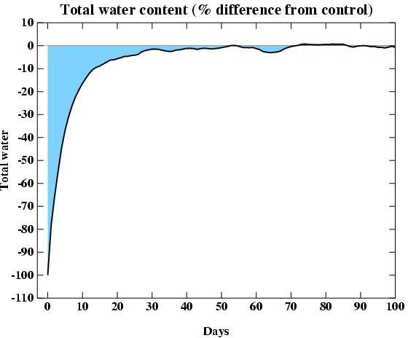
Time for Replenishment of Atmospheric Water Vapour
Most vapour is replenished within less than 10days
Source: http://www.realclimate.org/index.php/archives/2005/04/water-vapour-feedback-or-forcing/

Slide 7
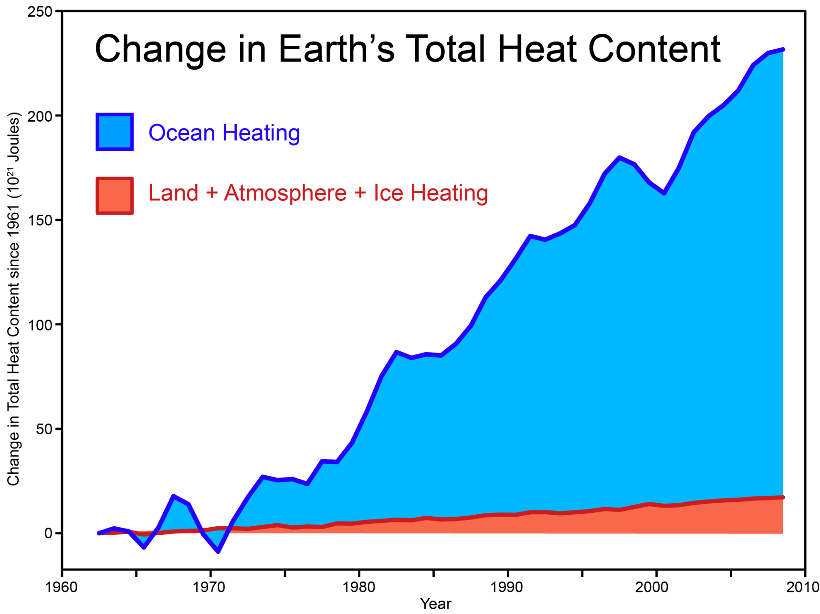
From Nuccitelli et al. (2012), described at skepticalscience.com.
For sustainability, this heat content must be stabilised.

Slide 8
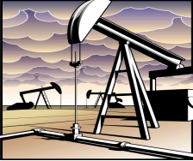
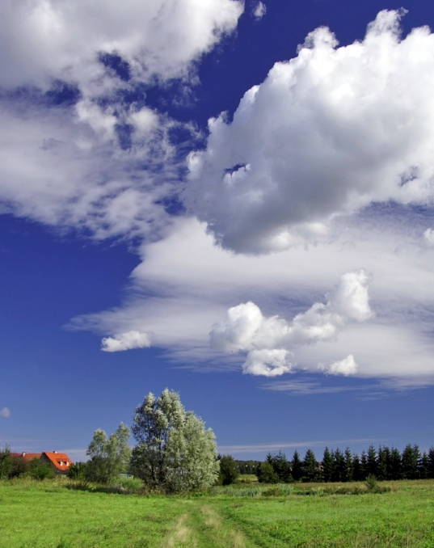

A Comparison of Earth’s Stored Energy Resources
Crude Oil Reserves
Latent heat of water vapor in the bottom kilometre of the atmosphere
Heat content of tropical ocean water
100 m layer, 3°C
100 m depth
1 km
height
7.3 x 10²¹ J
13 x 10²¹ J
130 x 10²¹ J
Replenishment times
10⁹ years
10 days
100 days
Eric Michaud

Slide 9
Assumptions / Calculations
Crude Oil Reserves
Latent heat of water vapor in the bottom kilometre of the atmosphere
Heat content of tropical ocean water
100 m layer, 3°C
[1]
[3]
[6],[7]
[2]
[4]
[8],[9]
[5]
[10]
[1] World Crude Oil and Natural Gas Reserves, January 1, 2007, Energy Information Administration
[2] Energy Calculator, Energy Information Administration, http://www.eia.doe.gov
[3] Assuming 10 kg/m² average moisture content in the bottom 1 km of the atmosphere
[4] Latent heat of water vapour (conservative value neglecting the latent heat of fusion)
[5] Surface area of the Earth
[6] density of water
[7] Assuming 100 m depth
[8] sensible heat of water
[9] Assuming 3°C
[10] Assuming the area of Earth’s tropical oceans = Area of Earth x 20%
From original figures supplied by Eric Michaud

Slide 10
The Troposphere
Trópos – Greek for “turning” - mixing
The troposphere is the lowest of the strata within the atmosphere. It is well mixed by convection, but there are meteorological factors which inhibit the convection process
An important factor in convection is the release of energy contained within water vapour, principally in the form of latent heat of fusion and vaporization
It will be shown that effective convection within the troposphere is crucial for mitigating global warming

Slide 11
Overview
Global warming occurs when the incoming solar energy exceeds that being radiated back into Space from the upper atmosphere in the form of infra-red radiation.
Well over half the outward transmission of energy from the Earth’s surface through the troposphere occurs in the form of convection.
There is often a significant barrier to convection within a “boundary” layer in the lowest two kilometres of the troposphere. This impediment can be reduced by several methods. One of these is arguably the vortex engine.

Slide 12
Three concepts are arguably able to significantly enhance tropospheric convection:
  The gravity tower
  The solar updraft tower
  The vortex engine

Slide 13
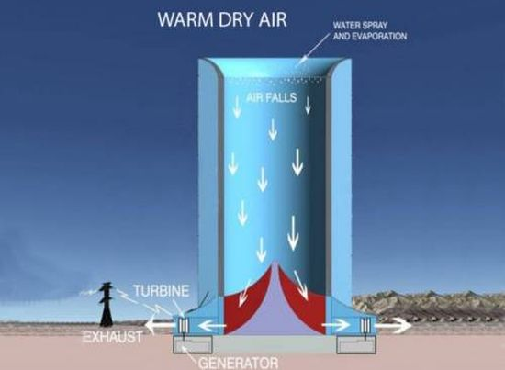
First, the Gravity Tower
A Solar Wind Energy Tower proposed for Arizona has a design capacity of 450 MW. (4 x 10⁹ kWhr per annum)
680 m high, 350 m diameter. Projected cost $1.5 billion.

Slide 14
Second, the Solar Updraft Tower
Enviromission
800 m high, 130 m diameter. Collector ~30 sq km
200 MW, 300 tonne/sec
Australia / US
1 tonne/s
Enviromission has committed to build a 200 MWe solar-thermal power station, also in Arizona.
800 m high. Projected cost $750 million.
Press release 1/9/15 - EnviroMission Signs US$110M Funding Heads of Agreement.

Slide 15
Third, the Vortex Engine
Vortex formed
Solid canopy around one kilometre diameter over air intake
Boundary layer “fence”
Main swirl chamber
Adjustable dampers downstream of turbines modulate and guide the flow of hot air into the main vortex chamber.
Turbine inlets
Swirl vanes
Air picks up heat from pipes beneath a canopy creating a water-to-air heat exchanger, before entering the vortex engine main swirl chamber

Slide 16
The power of the vortex to penetrate the convective inhibition layer
“Funnel” of visible rising water vapour and warm air
Air at altitude rotates with the vortex and cannot enter the cone of the vortex eye.
On the other hand, less dense water vapour content is preferentially displaced towards the eye by the centrifugal field
Moist air within the stagnant boundary layer is able to move towards the low pressure “eye” due to the relative lack of centrifugal force
The vortex mechanism inherently minimizes entrainment between the highly buoyant updraft stream and the surrounding atmosphere

Slide 17
The mass flowrate of air through the 200 MW vortex engine would be in the region of 30 tonne/s:
Assuming
1% water vapour content, the water mass flowrate through the system would be 300 kg/s.
All the water vapour is converted to ice at -70C at the top of the troposphere the power available is 300 x 3,500 = 1050 MW.
The power available from the sensible heat of the air, based on ΔT of 100C is 30 MW.
Based on an overall plant efficiency of 20%, the output would be around 200 MW.

Slide 18
The height to which a buoyancy vortex persists before breakdown to a turbulent plume will depend on:
Convective Available Potential Energy (CAPE)
System scale
Radiation of heat away from the plume
The CAPE of the gas stream is a function of the internal energy of the convecting fluid. In tornadoes, the latent heat of fusion and evaporation of water vapour are important in this regard. Calculation of CAPE is covered at http://tornado.sfsu.edu/geosciences/classes/m201/buoyancy/CAPE_Procedure.html

Slide 19
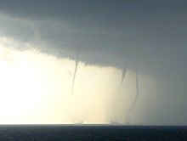
Waterspouts seen from the beach at Kijkduin near The Hague, the Netherlands on 27 August 2006.
Although having a very modest temperature differential with the ambient atmosphere, these vortices are rising 8-10 km through the troposphere

Slide 20
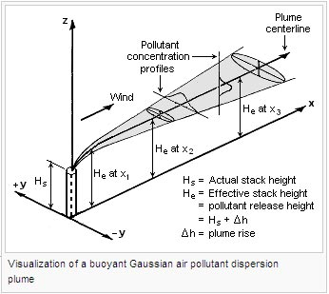
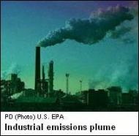
On the other hand, a non-rotating plume has an inherently high level of entrainment
The temperature differential involved is much higher than the waterspouts, but entrainment of the surrounding air severely inhibits convection

Slide 21
The use of enhanced thermal inertia with Solar Updraft Towers and Vortex Engines in order to generate base load (essentially 24 hr/day) power:

Slide 22
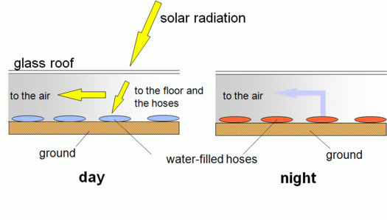
Updraft tower –
Enhanced thermal inertia
Water-filled tubes

Slide 23
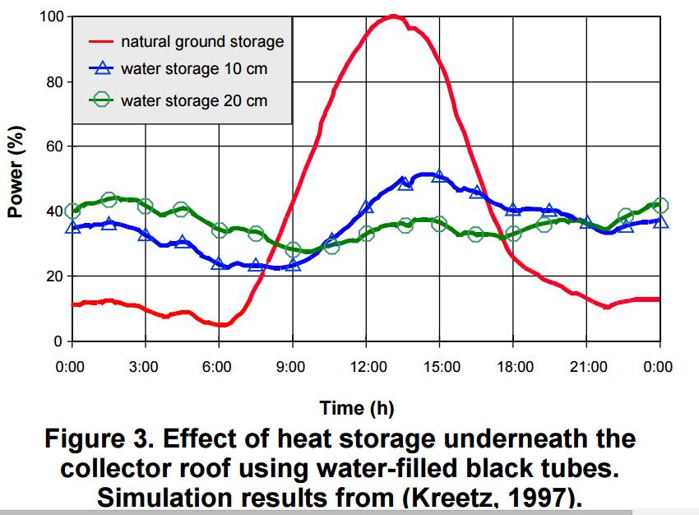
Updraft Tower – enhanced thermal Inertia

Slide 24
Solar updraft tower with water storage over 25% collector area
The above graphs relate to Switzerland latitude 47 degrees N.
The hours of sunlight in winter are relatively low.

Slide 25
Sectional diagram of Proposed Vortex Engine
Vortex “funnel”
Opaque insulated canopy approx. 2 km diameter
Guide vanes generate swirl in the air flowing to the vortex centre
~ 90ºC hot water from geothermal reservoirs recycled through HDPE pipe coils acting as water-to-air heat exchangers under the collector area of the canopy.

Slide 26
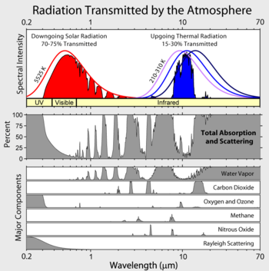
The importance of tropospheric convection for the mitigation of global warming
The deficit between downgoing and upgoing radiation must be made up for by convection processes
Water vapour is by far the most critical greenhouse gas
NASA

Slide 27
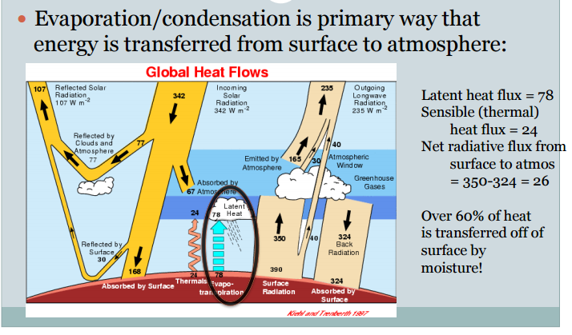
The importance of latent heat in convection
http://www.atmos.washington.edu/~dargan/587/587_3.pdf
Convection of water vapour through the troposphere provides by far the most effective single way in which Earth’s heat can eventually be re-radiated to Space.
As greenhouse gases such as CO₂ and H₂O increase, so too, must convection processes.

Slide 28
The Earth’s surface is the troposphere’s “heating element”
“The [atmosphere] is heated from the ground up because the surface of the Earth absorbs energy and heats up faster than the air. The heat is mixed through the troposphere because on average the atmosphere in this layer is slightly unstable.”
University Corporation for Atmospheric Research
http://www.windows.ucar.edu/tour/link=/earth/Atmosphere/layers_activity_print.html&edu=high

Slide 29
Problems with natural tropospheric convection
  “Study: Warmer World Will Produce Fewer Clouds” January 03, 2014
  http://www.voanews.com/content/study-warmer-world-will-produce-fewer-louds/1822952.html
  Steven Sherwood, a climate scientist at Australia's Centre of Excellence for Climate System Science and lead author of the report, says the prediction of a 4º Celsius warming is based on the role of water vapour in cloud formation:
  “What we see in the observations is that when air picks up water vapour from the ocean surface and rises up, it often only rises a few kilometres before it begins its descent back to the surface," Sherwood said. "Otherwise it might go up 10 or 15 kilometres. And those shorter trajectories turn out to be crucial to giving us a higher climate sensitivity because of what they do to pull water vapour away from the surface and cause clouds to dissipate as the climate warms up.”
  (Emphasis added)

Slide 30
What this means
reflection to Space
-70ºC
tropopause
evaporation
precipitation
=> Higher tropospheric humidity
=> Lower tropospheric humidity
convection
earth
Non-rotating updrafts lead to global warming.
Rotating updrafts reduce global warming.

Slide 31
Ramifications
With modest convection updraft velocities, temperature loss from the updraft plume via radiation and mixing may be excessive, leading to:
Ineffective or incomplete convective heat transfer through the troposphere.
Mid-level clouds. The subsequent evaporation of the clouds boosts the build-up of atmospheric water vapour.
The high updraft efficiency typical of vortex flow leads to:
High level reflective clouds
High precipitation efficiency, hence removal of water vapour from the atmosphere

Slide 32
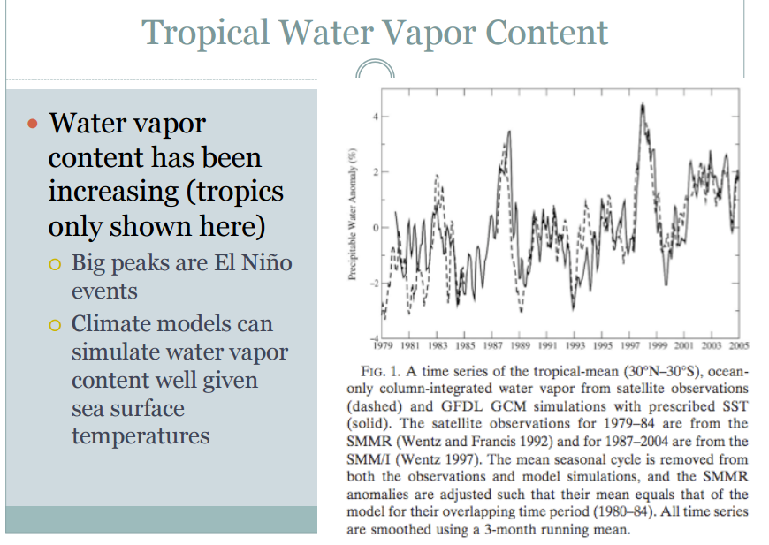
Sea temperatures are rising
http://www.atmos.washington.edu/~dargan/587/587_3.pdf

Slide 33
Water vapour sequestration and storage
One proposal for reducing the greenhouse effect is to sequester and store CO_{2.}
That is an extremely difficult and costly process.
There is a cheap and easy alternative: Remove water vapour on an ongoing basis and store it below ground and in the oceans. The vortex engine can do this.

Slide 34
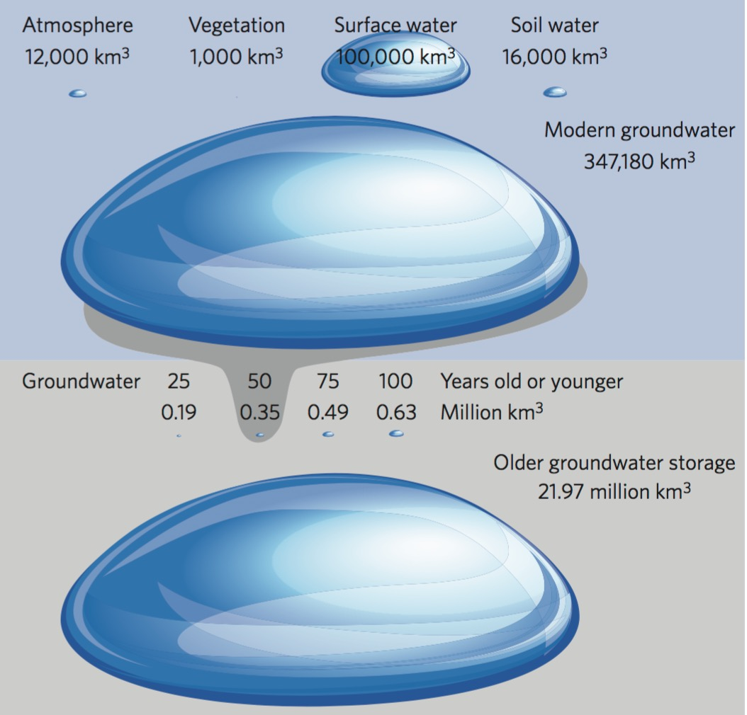
Earth’s Freshwater Resources
Forbes
http://www.forbes.com/sites/trevornace/2015/12/21/scientists-map-hidden-groundwater-reserves-around-world/#6171c3657079

Slide 35
The groundwater storage, if laid out over the Earth’s land surface of 510 million square kilometres, would have a notional reservoir mean depth of 43 m:
Depth = 22 x 10⁶ / 510 x 10⁸ km
= 43 metres
Hence the groundwater reservoir capacity is many orders of magnitude greater than that required for control of the atmosphere’s water vapour content.

Slide 36
The ramifications of H₂O and CO₂ build-up
There will be climate warming unless there is some sort of negative feedback:
“…My opinion is that the cloud feedback is the only place where… a large negative feedback [to mitigate global warming] can lurk. If it is not there, and the planet does not reduce emissions, then get ready for a much warmer climate…”
6/01/2010
(Emphasis added)
Professor Andrew Dressler - Department of Atmospheric Sciences of Texas A&M University
http://pielkeclimatesci.wordpress.com/2010/01/06/guest-post-by-andrew-dessler-on-the-water-vapor-feedback/

Slide 37
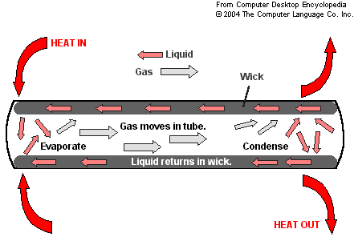
The Heat Pipe
Q_{in}
Q_{out}
The heat pipe is an extremely effective device for transmitting heat.
For equilibrium, the heat input Q_{in} must equal the heat output Q_{out}.

Slide 38
The Troposphere: Nature’s “Heat Pipe”
Convection processes such as storms, cyclones and tornados are the primary means of effectively pumping heat out of the ocean, into the atmosphere, and lifting it to where it can be re-radiated into space, thereby mitigating the heat build-up that would otherwise occur.
Cyclones should be regarded as “safety valves” of the atmosphere.

Slide 39
But cyclones are reportedly reducing in frequency:
“There are a number of modelling studies that suggest the frequency or total number of cyclones in some ocean basins, including the South Indian and South Pacific, will decrease as a function of global warming.”
“One recent study examining the frequency of tropical cyclone activity in the Australian region showed that total seasonal cyclone activity was at its lowest level in 1500 years in Western Australia and in 500 years in north Queensland…”
http://theconversation.com/factcheck-is-global-warming-intensifying-cyclones-in-the-pacific-38984
And the strongest cyclones are getting stronger:
"We should not be worried about the frequency of hurricanes; we should be worried about the frequency of intense hurricanes," said Kerry Emanuel, professor of atmospheric science at the Massachusetts Institute of Technology. "Climate change is causing a greater number of intense storms…”
http://www.livescience.com/28489-sandy-after-six-months.html
(Emphasis added)
Why are the strongest becoming more frequent?

Slide 40
Cyclone formation is being inhibited by strengthened jet streams in the northern and southern hemispheres:
“…When upper-level winds are present during the hurricane season, the gusts can create wind shear, which greatly inhibits storm formation.
That's because winds blow across the top of the hurricane, preventing the storm's circulation from gaining the momentum it needs to develop more power…”
http://news.nationalgeographic.com/news/2008/04/080424-winds-warming.html
“…Records of hurricane activity worldwide show an upswing of both the maximum wind speed in and the duration of hurricanes. The energy released by the average hurricane (again considering all hurricanes worldwide) seems to have increased by around 70% in the past 30 years or so, corresponding to about a 15% increase in the maximum wind speed and a 60% increase in storm lifetime...”
“…the amount of damage increases roughly as the cube of the maximum wind speed in storms, so in practice we are concerned more with intense storms…”
http://eaps4.mit.edu/faculty/Emanuel/publications/position_paper

Slide 41


Slide 42
Temperature profiles of updraft
vortices within the troposphere
10 k
Dry adiabat
Moist adiabat
Sounding temperature
Altitude
Lifted condensation level LCL
-70C
Temperature
30C

Slide 43
Ideal temperature profile graph for
updraft vortices within the troposphere
Australia – warm and dry
EL
10 k
Dry adiabat
CAPE
Convective available potential energy
Moist adiabat
Sounding temperature
Altitude
Lifted condensation level LCL
-70C
Temperature
30C
90C

Slide 44
Ideal temperature profile graph for
updraft vortices within the troposphere
Shenzhen – warm and humid
EL
10 k
Dry adiabat
CAPE
Convective available potential energy
Moist adiabat
Sounding temperature
Altitude
Lifted condensation level LCL
-70C
Temperature
30C
90C
Assuming 2% water vapour by weight – ideal CAPE is

Slide 45
Ideal temperature profile graph for
updraft vortices within the troposphere
Beijing – cold and dry
EL
10 k
Dry adiabat
CAPE
Convective available potential energy
Moist adiabat
Sounding temperature
Altitude
Lifted condensation level LCL
-80C
Temperature
10C
80C

Slide 46
Heat loss from the plume
The ideal temperature profile of the dry and moist adiabats assume that:
No heat is transferred from the updraft plume by radiation or conduction
There is no mixing of the plume air with the surrounding atmosphere
This is an approximation of what happens within an updraft vortex.
Oxygen and nitrogen, which together make up 98% of the atmospheric air, have very low emissivities in the frequency band (infra-red) where radiation would otherwise occur.
As discussed, the vortex mechanism acts to sequester the plume from the surrounding atmosphere, thus severely limiting conduction and mixing.

Slide 47
The Vortex Engine can leverage heat transfer by use of the energy of atmospheric water vapour
Heat radiated to Space from top of troposphere
Tropical – warm and humid
EL
10 k
Dry adiabat
CAPE
Convective available potential energy
Moist adiabat
Sounding temperature
Altitude
-70C
Temperature
30C
90C
Heat energy from geothermal
Heat energy from atmospheric water vapour

Slide 48
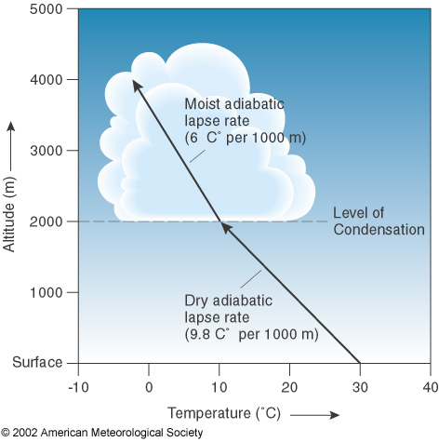
(LCL)

Slide 49
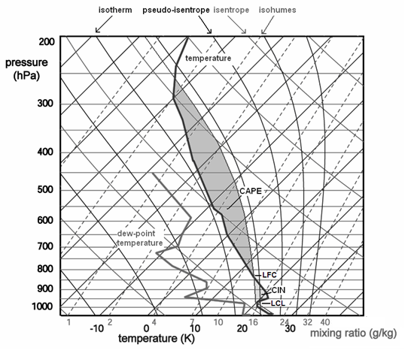
“Speed Bumps” in the temperature profile
Inversion layer

Slide 50
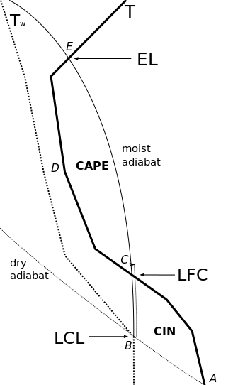
Diagram showing an air parcel path when raised along A-B-C-E compared to the surrounding air mass Temperature (T) and dew point temperature (Tw)
An air parcel heated by the earth follows a dry adiabat up to the LCL
and then a moist adiabat up to the EL (equilibrium level) at the top of the troposphere
The level of free convection (LFC) is the altitude in the atmosphere where the temperature of the environment decreases faster than the moist adiabatic lapse rate of a saturated air parcel at the same level.
CAPE = convective available potential energy
CIN = Convective inhibition
T

Slide 51
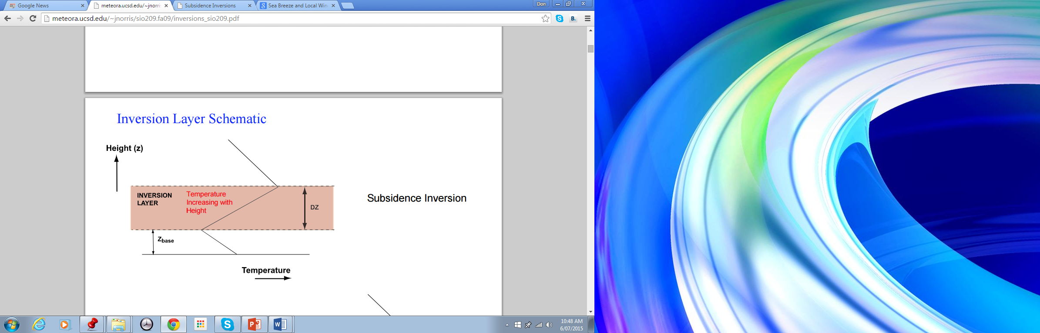
Inversion layers interfere with
the convection process
Inversion layer
Temperature increasing with height
ΔZ
Inversion layers tend to inhibit convection because the updraft has to be able to overcome the negative buoyancy while going through the inversion.
The vortex engine will enable the plume to break through to the free convection zone

Slide 52
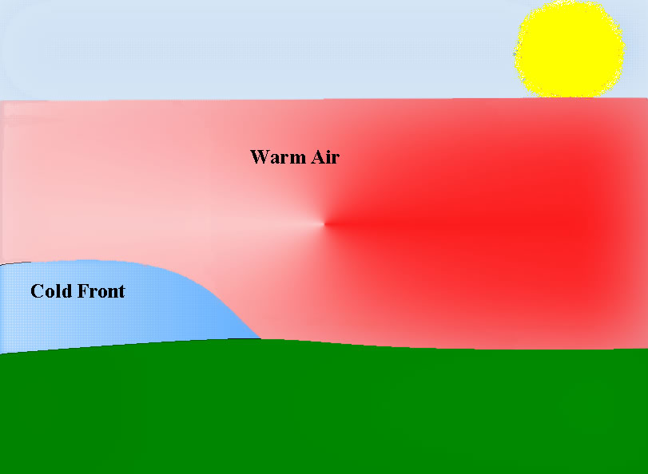
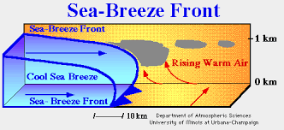
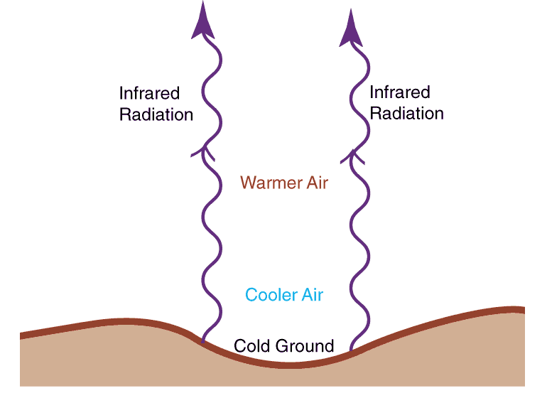
Inversion layer formation
Cold front inversion
Marine inversion
Boundary layer
Radiation inversion

Slide 53
Solar Updraft Tower
Vortex Engine
Atmospheric Vortex Engine
~10 km
Heavy entrainment
Minimal entrainment
~2 km
Uses ambient air
Uses ambient air
Uses either humid tropical ambient air and/or waste heat from conventional thermal power plant
Geothermal Hot Sedimentary Aquifer

Slide 54
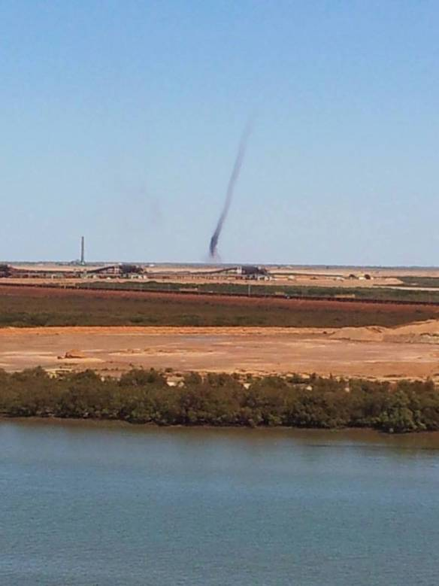
Natural convective vortices
Image Credit: ©Troy Bourne / Perth Weather Live
A large dust devil near Port Hedland. The stack on the left is 116m high!
https://pwlinfo.wordpress.com/2013/11/20/willy-willy-dust-devil-or-cockeyed-bob/

Slide 55
Progress in funding for Vortex Engines
PayPal co-founder and Facebook investor, Peter Thiel, funded construction of a Canadian prototype to US$300,000 in 2012. This system is intended to ultimately utilise waste heat from power station cooling towers
The US Department of Energy through the Advanced Research Projects Agency-Energy (ARPA-E) has funded a group led by Georgia Institute of Technology (GATECH) for US$3.7 million in 2014. This system is intended to utilise solar energy within arid regions.

Slide 56
The Canadian concept is for a stand-alone power plant with a capacity of about 200 MWe
The GATECH concept is based (at least initially) on using a large array of relatively small vortex engines each of around 50 kWe, with a combined output of around 16 MWe/km².

Slide 57
“Reap the whirlwind for cheap renewable power”
New Scientist
11 March 2013 by Hal Hodson
http://www.newscientist.com/article/mg21729075.400-reap-the-whirlwind-for-cheap-renewable-power.html#.VaHVMfmqqkp
Article on the Gatech research project:
“…Simpson has tested a small, 1-metre version of the vortex that drives a turbine to create a few watts of power using nothing more than a hot, sun-baked metal sheet. However, the power output scales up rapidly as you increase the turbine's diameter.
Simpson calculates that a 10-metre turbine will produce 50 kilowatts of power using the same method. The team says that an array of these vortex turbines could produce 16 megawatts for every square kilometre they cover. This is not bad considering conventional wind turbines yield just 3 and 6 megawatts per square kilometre.
In fact, the team estimates that the electricity produced by a Solar Vortex will be 20 per cent cheaper than energy from wind turbines and 65 per cent cheaper than solar power.”

Slide 58
“Dust Devils Power Energy Machine”
Discovery Magazine
Feb 28, 2013 by Eric Niiler
http://news.discovery.com/tech/alternative-power-sources/dust-devils-power-energy-machine-130228.htm
ARPA-E quote:
‘“It’s part of our mission to look for disruptive energy technologies that are typically earlier stage and higher risk than other agencies or commercial entities would take on,” Willson said. “They also have to be based on sound science.” ’

Slide 59
The GaTech consortium’s proposed array of moderately-sized vortex engines has the advantage of keeping the energy level at each engine relatively low, and hence providing a “stepping stone” to a full scale system.
The disadvantages of a 10 m dia. system would be:
  The power of the updraft plume is insufficient to penetrate inversion layers and other conditions of convective inhibition.
  With a plume height of approximately 1 km, a maximum thermal efficiency in the region of only 3% could be expected, as against around 30% for that for the full tropospheric-scale (10 km) concept.

Slide 60
Will vortices work?
‘…Nilton Renno, a professor at the department of atmospheric, ocean and space sciences at the University of Michigan, has spent his career studying tornadoes and water spouts. He says there is no reason why [the] vortex engine wouldn’t work.’
Still, Renno isn't without reservations. He's particularly concerned about the ability to control such a powerful monster.
"The amount of energy involved is huge. Once it gets going, it may be too hard to stop," he says.
The Toronto Star, July 21 2007
“…‘The science is solid,’… ‘Once you induce circulation nearby, the vortex can be self-sustaining.’ ”
Discovery, Feb 28 2013
“…What’s necessary at this point is to do proofs of concept,” says professor Kerry Emanuel, the hurricane expert at MIT. “[The] idea is pretty simple and elegant. My own feeling is that we ought to be pouring money into all kinds of alternative energy research. There’s almost nothing to lose in trying this...”
ODE Magazine, March 2008

Slide 61
Conclusions
Convection within the troposphere is critical in order to prevent global warming
Convection is currently significantly inhibited by several atmospheric mechanisms including
  Inversion layers
  Atmospheric brown clouds
The atmospheric vortex engine can arguably help to overcome these inhibitory factors and in doing so yield significant energy, additional precipitation and a cooler atmosphere

Slide 62
NATURÆ ENIM NON IMPERATUR, NISI PARENDO
WE CANNOT COMMAND NATURE EXCEPT BY OBEYING HER
Francis Bacon

Slide 63
Quick Links:
The AVETec Website: http://vortexengine.ca
The Sky's the Limit (ASME Mechanical Engineering Journal)
http://memagazine.asme.org/Articles/2011/April/Skys_Limit.cfm
Buoyancy-Induced Columnar Vortices for Power Generation
http://www.fmrl.gatech.edu/drupal/projects/solarvortex
http://arpa-e.energy.gov/?q=slick-sheet-project/power-generation-using-solar-heated-ground-air
http://news.discovery.com/tech/alternative-power-sources/dust-devils-power-energy-machine-130228.htm
http://www.newscientist.com/article/mg21729075.400-reap-the-whirlwind-for-cheap-renewable-power.html#.VaHVMfmqqkp
Gravity Towers
http://www.ecochunk.com/5962/2013/02/04/downdraft-tower-uses-solar-energy-to-produce-wind-for-low-cost-wind-power/
Amazon Rainforest
http://www.i-sis.org.uk/importanceOfTheAmazonRainForest.php
Contact: vortexengineer@gmail.com

Slide 64
Scientific American
August 2015
Energy, Water and Food Problems Must Be Solved Together
Our future rides on our ability to integrate how we use these three commodities
By Michael E. Webber
“In July 2012 three of India's regional electric grids failed, triggering the largest blackout on earth. More than 620 million people - 9 percent of the world's population—were left powerless.”
“The cause: the strain of food production from a lack of water. Because of major drought, farmers plugged in more and more electric pumps to draw water from deeper and deeper below ground for irrigation. Those pumps, working furiously under the hot sun, increased the demand on power plants. At the same time, low water levels meant hydroelectric dams were generating less electricity than normal…”

Slide 65
BACKGROUND MATERIAL

Slide 66
Water harvesting

Slide 67
Professor Kerry Emanuel MIT
"...they have created what they call a dynamic chimney where they create a giant greenhouse over the desert floor and in the middle of the glass you have a chimney... The sun makes it very hot in there and the air goes rushing up the chimney, and you apply a swirl to that, which is essentially a tornado. The beauty of it is that once it leaves the chimney it keeps going and that is important because the thermodynamic efficiency of the engine is basically proportional to the temperature difference between the bottom and the top, and 100 feet is tall enough for that temperature difference to be appreciable, but if the column of rotating air goes a kilometre into the sky, you now have a change in temperature of about 10 degrees, and they use that to generate electricity.”
“If salt water is used instead of just the desert surface, you have a much higher albedo [reflectivity] so you get more efficient generation. You get moist air going up, which means it can go higher into the atmosphere, and then the rain that comes down can be harvested into fresh water!..."
Worldchanging Interview: Kerry Emanuel, Climate Scientist
David Zaks, 27 Feb 07

Slide 68
Hybrid Power and Water Production
Another method of getting water
Kashiwa BA; Kashiwa, CB (2008). "The solar cyclone: A solar chimney for harvesting atmospheric water". Energy 33 (2): 331–339.
Zhou, X.; Xiao, B.; Liu, W.; Guo, X. et al. (2010). "Comparison of classical solar chimney power system and combined solar chimney system for power generation and seawater desalination"

Slide 69
Impediments to natural convection within the troposphere

Slide 70

Marine Inversion

Slide 71
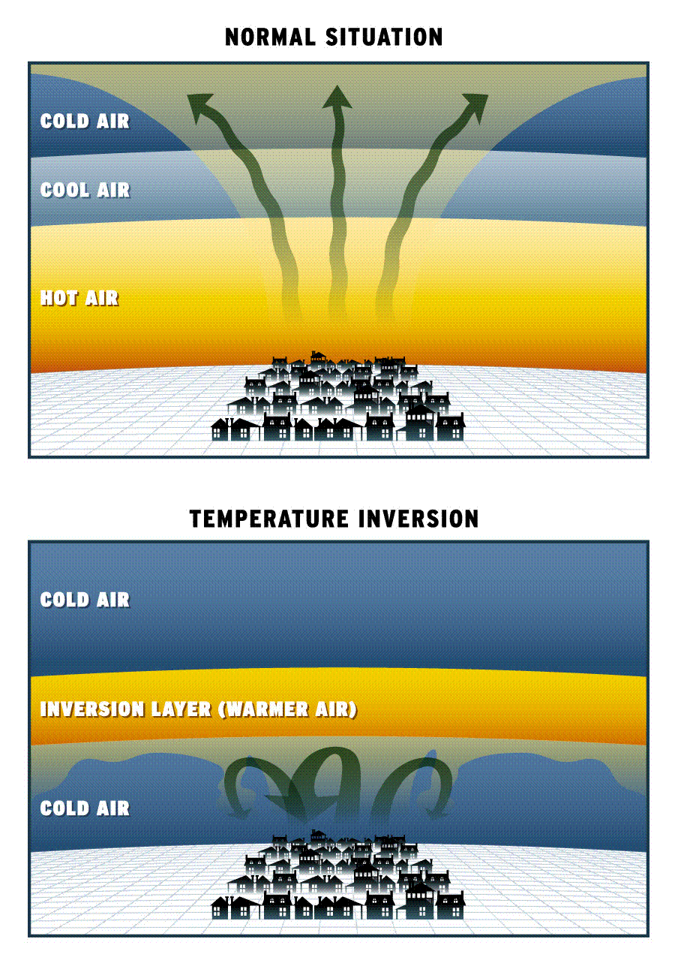
The Effect of Inversions

Slide 72
At any given time, a significant percentage of the Australian continent could be expected to be “blanketed” by temperature inversions of some type, thus inhibiting convection. Even without an inversion, an inhibited convective layer often occurs in the first approx. 2 km.
The vortex engine of the right scale would enhance convection in the troposphere. This would arguably cool the local environment and create a positive feedback loop to reverse desertification in the interior of the continent.

Slide 73
There is evidence that gradual convection is relatively inefficient in reducing the greenhouse effect. With higher atmospheric temperatures, low to medium level clouds which form have a correspondingly increased evaporation rate and hence dissipate more quickly:
  Steven Sherwood, a climate scientist at Australia's Centre of Excellence for Climate System Science and lead author of the report, says the prediction of a 4º Celsius warming is based on the role of water vapour in cloud formation.
  “What we see in the observations is that when air picks up water vapour from the ocean surface and rises up, it often only rises a few kilometres before it begins its descent back to the surface," Sherwood said. "Otherwise it might go up 10 or 15 kilometres. And those shorter trajectories turn out to be crucial to giving us a higher climate sensitivity because of what they do to pull water vapour away from the surface and cause clouds to dissipate as the climate warms up.”
  http://www.voanews.com/content/study-warmer-world-will-produce-fewer-clouds/1822952.html
Fast convection producing high level [rain] clouds also has the effect of producing a drier atmosphere, as much of the precipitation enters the ground-water system or is returned to the ocean. As water vapour is the most critical greenhouse gas, this would also reduce the greenhouse effect.
Aerosols in the atmospheric brown cloud have also been shown to reduce the strength of the global monsoon system (see later).

Slide 74
Possible Negative Feedback from Cloud Cover
“…Given the strong water vapor feedback seen in observations (~2 W/m²/K), combined with estimates of the smaller ice-albedo and lapse rate feedbacks, we can estimate warming over the next century will be several degrees Celsius. You do not need a climate model to reach this conclusion — you can do a simple estimate using the observed estimates of the feedbacks along with an expectation that increases in carbon dioxide will result in an increase in radiative forcing of a few watts per square meter.
The only way that a large warming will not occur in the face of these radiative forcing is if [there is] some presently unknown negative feedback that cancels the water vapor feedback. My opinion is that the cloud feedback is the only place where such a large negative feedback can lurk. If it is not there, and the planet does not reduce emissions, then get ready for a much warmer climate…”
Professor Andrew Dressler - Department of Atmospheric Sciences of Texas A&M University
http://pielkeclimatesci.wordpress.com/2010/01/06/guest-post-by-andrew-dessler-on-the-water-vapor-feedback/
The Vortex Engine’s high level cloud production in conjunction with reafforestation should significantly increase local cloud cover.

Slide 75
The Interrelationship between
Insolation and Precipitation
The average annual precipitation of the entire surface of our planet is estimated to be about 1050 millimetres per year. (Source PhysicalGeography.net).
The average global insolation at the surface of the Earth is estimated as 180 W/m² (Source PhysicalGeography.net). Over one year, this would be equivalent to the energy required to produce an evaporation rate of about 1600 millimetres, but part of the energy would inevitably go to heating atmospheric air.
Hence around two thirds of the solar energy reaching the Earth’s surface goes to the evaporation of water and creation of a “heat pipe” effect, which eventually dumps heat back to Space.

Slide 76
Global Warming predictions

Slide 77
The following text is extracted from MIT Professor Kerry Emanuel's book "What We Know About Climate Change," published in 2007. It appears to be apposite to the current situation:
The global mean temperature is now greater than at any time in at least the past 500 to 1,000 years...
Rainfall will continue to become concentrated in increasingly heavy but less frequent events.
The incidence, intensity, and duration of both floods and drought will increase.
The intensity of hurricanes will continue to increase, though their frequency may dwindle.
Even if we believed that the projected climate changes would be mostly beneficial, we might be inclined to make sacrifices as an insurance policy against potentially harmful surprises.

Slide 78
The Atmospheric Temperature Profile

Slide 79
The Atmospheric Temperature Profile
Thermosphere
80 km
Mesosphere
50 km
Stratosphere
Ozone Layer
10 km
Troposphere
Temperature
-90ºC -70ºC 0ºC 30º C
SIMPLIFIED GRAPH OF ATMOSPHERIC TEMPERATURE PROFILE

Slide 80
The Atmospheric Temperature Profile:
With relation to the previous diagram, generally atmospheric temperature declines with altitude except where:
  “solar wind” particles are intercepted in the thermosphere which includes the ionosphere.
  incoming solar radiation is absorbed in the stratosphere (in which the ozone layer lies),
  and

Slide 81
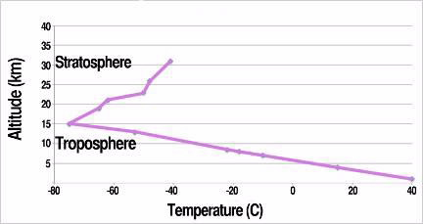
Measured profile above Tucson Arizona
The figure shows the observed atmospheric temperature as a function of altitude over Tucson, AZ, in late afternoon, 14 August 2000, when the surface temperature was 36.7 °C.

Slide 82
The Troposphere
“The troposphere is the lowest region of the Earth's atmosphere, where masses of air are very well mixed together and the temperature decreases with altitude.”
“The air is heated from the ground up because the surface of the Earth absorbs energy and heats up faster than the air. The heat is mixed through the troposphere because on average the atmosphere in this layer is slightly unstable.”
http://www.windows.ucar.edu/tour/link=/earth/Atmosphere/layers_activity_print.html&edu=high
The proposed vortex engine is basically a system to enhance the transmission of energy through the troposphere by convection.

Slide 83
Updraft Clouds
Updraft velocities of up to 240 km/hr. have been recorded - enough to hold hailstones of up to 178 mm diameter aloft.
Atmospheric water vapor should arguably be regarded as a storehouse of solar energy.

Slide 84
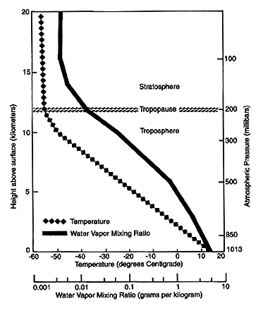
pressure
0
100 kPa

Slide 85
Vapour emissions from Industry

Slide 86
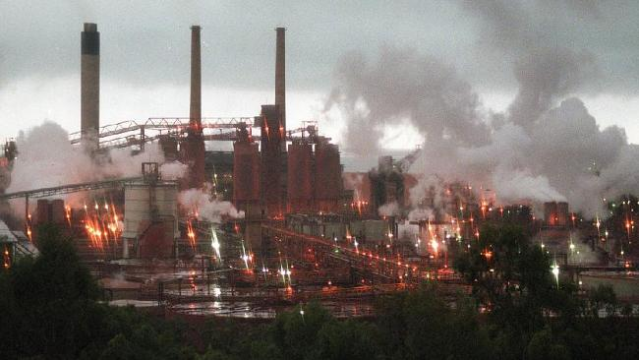
Vapour emissions from an alumina refinery
For every tonne of alumina produced, around half a tonne of water vapour is emitted through calcination alone. This amounts to approximately 7 Megatonne per annum in Western Australia.
This also corresponds to around 770 MW of thermal energy, from which the vortex engine should be able to generate 20%, or 150 MWe.

Slide 87
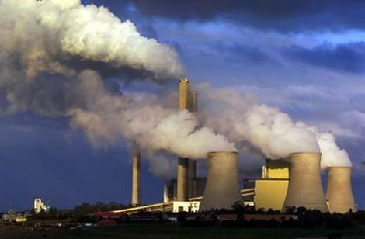
Vapour emissions from 2 GW Loy Yang power station
Water is vaporised a) within the wet cooling towers and b) in the combustion of the 30 Megatonne pa of brown coal which is around 60% water by weight.
The approximate annual vaporisation for cooling tower emissions is 34 Megatonne and 18 Megatonne in combustion of the fuel => 52 Megatonne total, or 5.7 GW_{th}.
The vortex engine should be able to generate around 1.2 GWe from this.

Slide 88
Plume energy lost through radiation

Slide 89
Plume energy lost through radiation
q = ε σ (T_{h}⁴ - T_{c}⁴) A_{c}
  where
  q = heat transfer per unit time (W)
  ε = emissivity
  σ = Stephan-Boltzmann constant
  T_{h} = hot body absolute temperature (K)
  T_{c} = cold surroundings absolute temperature (K)
  A_{c} = area of the object (m²)
The emissivity of H₂O and CO₂ are both high, whereas the emissivity of O₂ and N₂ which together make up the majority of gas in the atmosphere, are both very low. Hence an updraft within a vortex can approximate to an adiabatic process.
If the vertical velocity of the updraft is relatively low, water vapour may condense and freeze in the form of mid-level clouds.
For an updraft with ΔT between sea level and tropopause of 100C, and 1% water content, around 20% of the available change in enthalpy comes from water, 80% from the air.

Slide 90
Vortices in Nature

Slide 91
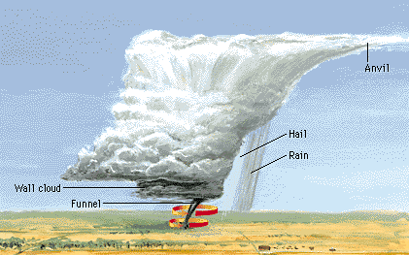
Vortices in Nature
World Book
The tornado is a highly effective mechanism through which Nature acts to convey humid boundary layer air to the top of the Troposphere where precipitation is initiated. The “anvil” is formed when it reaches the tropopause (ca. 10 km), the interface with the stratosphere.

Slide 92
Airflow in a vortex at altitude
Centrifugal force
Pressure gradient force
High pressure
Low pressure
Rotation
Diagram adapted from Divine Wind
At altitude, the pressure gradient force (inwards) exactly equals the centrifugal force (outwards). Air thus rotates without a significant radial component

Slide 93
Airflow in a vortex near ground level
Pressure gradient force
Centrifugal force
High pressure
Low pressure
Diagram adapted from Divine Wind
friction
Within the boundary layer, friction acts to reduce the rotational velocity and hence the centrifugal force. The air is consequently able to spiral towards the low pressure at the vortex centre.

Slide 94
The Power Dissipation of Atmospheric Vortices
The powers dissipated by vortices are in the order of:
  Tornado ~1 GW
  Tropical Cyclone ~3,000 GW
  Severe Tropical Cyclone ~30,000 GW

Slide 95
Positive Feedback Within a Vortex

Slide 96
Positive Feedback Within a Vortex
Warm air “rises” towards the centre (the eye) of the centrifugal field as it is less dense. It is also more buoyant in the Earth’s gravitational field and hence rises vertically when it reaches the eye.
Atmospheric water vapour, which has a mass density about 63% that of air at the same temperature and pressure, is also displaced towards the centre of the centrifugal field and rises vertically once in the eye.
Centrifugal force reduces the pressure at the centre of the centrifugal field. Low pressure again means low density and hence high buoyancy. A buoyant gas has inherent potential energy.
As the air/vapour mixture progresses to the low-pressure eye, some water vapour condenses, releasing latent heat. The typical tornado “funnel” is visible because of the condensed water particles.
Each of the above processes acts to create a strongly buoyant updraft within the eye and hence a self-sustaining natural “chimney” effect.
Just as the potential energy of elevated water can be harnessed to drive hydroelectric turbines, so too the potential energy of a warm air/vapour mixture can drive wind turbines.

Slide 97
Precipitation efficiency vs altitude

Slide 98
Precipitation Efficiency (ε_{p}) vs. Cloud Height
ε_{p} = 0
ε_{p} = 0.5
ε_{p} = 1
Tropopause
altitude 10 - 12 km
Altitude
Adapted from Divine Wind
Relative Humidity (RH)
RH
RH
Earth
When clouds reach the top of the Troposphere, precipitation efficiency tends towards unity. Some evaporation occurs during the descent of the rain, but this is not an entire loss as the evaporation causes cooling of the surrounding air, subsequent downdrafts, and horizontal wind when the flow hits the ground. Some of this energy can be harvested by means of conventional wind turbines.

Slide 99
The Carnot Engine

Slide 100
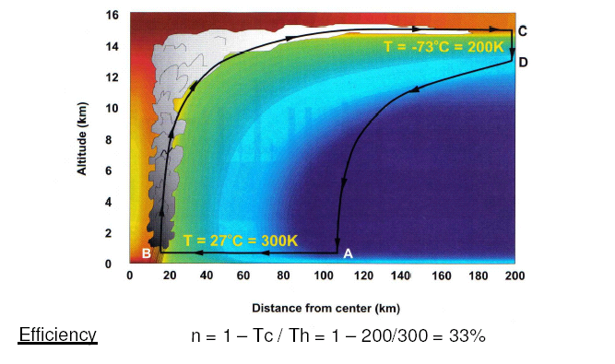
A Tropical Cyclone seen as a Carnot Cycle
(The colour coding indicates zones of equal entropy)
Source: Divine Wind by Kerry Emanuel

Slide 101
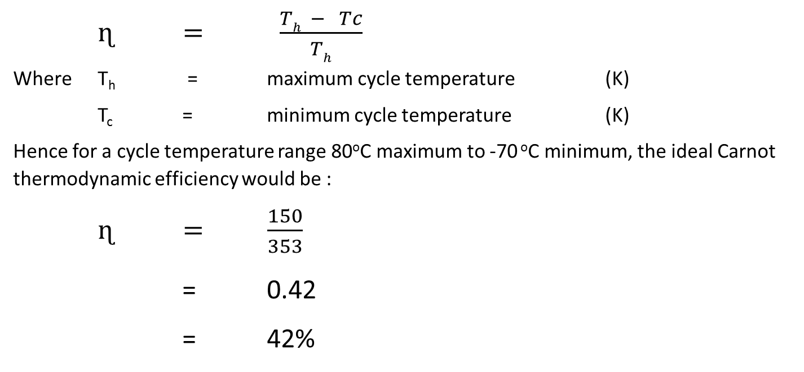
The Carnot Engine
The Carnot cycle has the equal highest possible theoretical efficiency of any thermodynamic cycle, but has not been practicable for use in mechanical heat engines.
The ideal thermodynamic efficiency of a Carnot cycle is a function of difference between the extreme temperatures of the cycle. The relationship between efficiency and temperature difference is given by

Slide 102
The GaTech project

Slide 103
Georgia Institute of Technology presentation summary
http://arpa-e.energy.gov/?q=slick-sheet-project/power-generation-using-solar-heated-ground-air
Quote:
“Georgia Tech is developing a method to capture energy from wind vortices that form from a thin layer of solar-heated air along the ground. "Dust devils" are a random and intermittent example of this phenomenon in nature. Naturally, the sun heats the ground creating a thin air layer near the surface that is warmer than the air above. Since hot air rises, this layer of air will naturally want to rise.
The Georgia Tech team will use a set of vanes to force the air to rotate as it rises, forming an anchored columnar vortex that draws in additional hot air to sustain itself. Georgia Tech's technology uses a rotor and generator to produce electrical power from this rising, rotating air similar to a conventional wind turbine.
This solar-heated air, a renewable energy resource, is broadly available, especially in the southern U.S. Sunbelt, yet has not been utilized to date. This technology could offer more continuous power generation than conventional solar PV or wind. Georgia Tech's technology is a, low-cost, scalable approach to electrical power generation that could create a new class of renewable energy ideally suited for arid low-wind regions.”
If successful, Georgia Tech's technology would reduce the cost of energy by 20% over wind power and 65% over solar photovoltaic energy.

Slide 104
“Reap the whirlwind for cheap renewable power” (cont’d)
“The US government's clean energy start-up shop is convinced: the Advanced Research Projects Agency Energy (ARPA-E) announced its decision to fund some large-scale trials last week. Simpson is due to present a paper in July detailing the trials at the ASME International Conference on Energy Sustainability in Minneapolis, Minnesota. Working with ARPA-E, Simpson and Glezer plan to have a 10 kW model running within two years, with tests on intermediate models scheduled for July. They want to build a 50kW model in the future.”
“ ‘The science is solid,’ says Nilton Renno, who researches thermodynamics at the University of Michigan. ‘Once you induce circulation nearby, the vortex can be self-sustaining.’ ”
“Steven Chu, the outgoing Energy Secretary, is interested; he visited the team briefly at the ARPA-E conference in Washington DC last week. ‘We would like to start with building a small-scale farm of these things,’ Simpson says. ‘At that point we start to produce real energy, and can begin to sell some of that energy and convince people of our system.’ “

Slide 105
GATECH research project participants:
Georgia Institute of Technology
University of Illinois, Urbana Champaign
University of Texas, Austin
United Technologies Research Center
National Renewable Energy Laboratory
ARPA-E (funder)

Slide 106
GATECH Quote:
“Recent outdoor tests of a meter-scale prototype coupled with a simple vertical-axis turbine placed on a surface directly heated by solar radiation, have demonstrated continuous rotation of the turbine with significant extraction of kinetic energy from the column vortex, in both the absence and presence of crosswind.”
The eventual full-scale Gatech proposal envisages a vortex with a 50 metre diameter core.

Slide 107
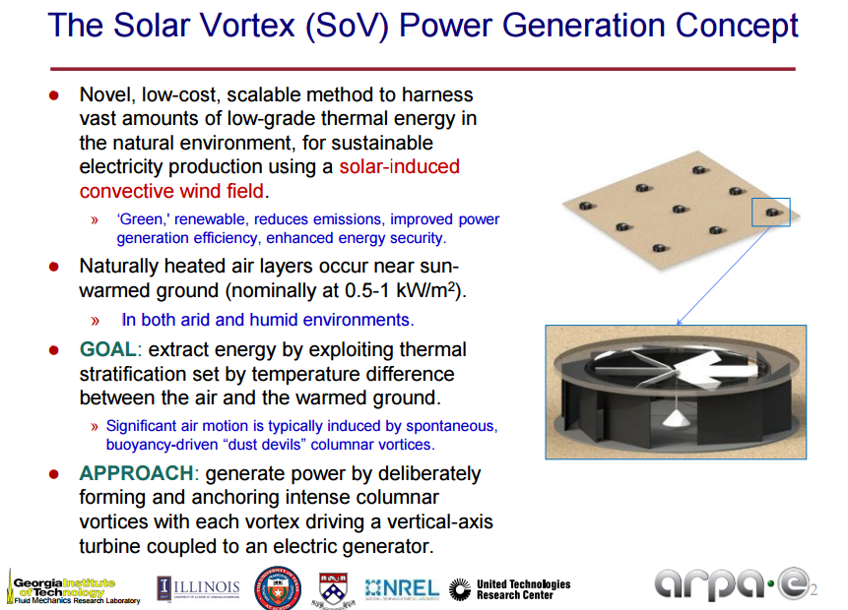
Array

Slide 108
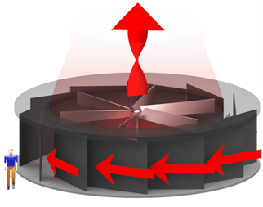
Gatech
Diagram of standard Module 10 m diameter, 3 m high

Slide 109
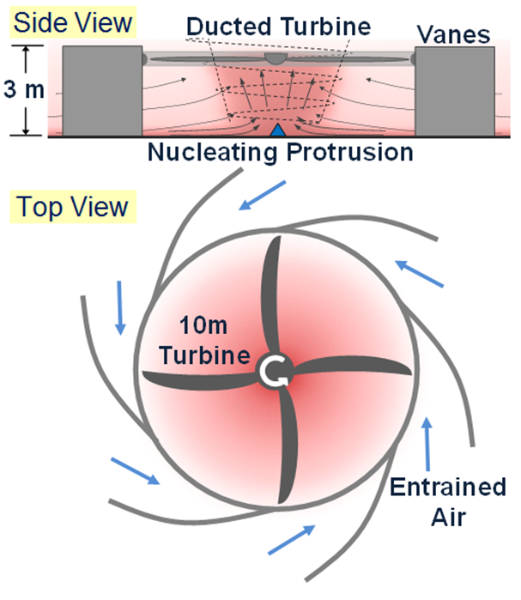
crosswind
Scoops compensate for plume dilution by crosswind

Slide 110
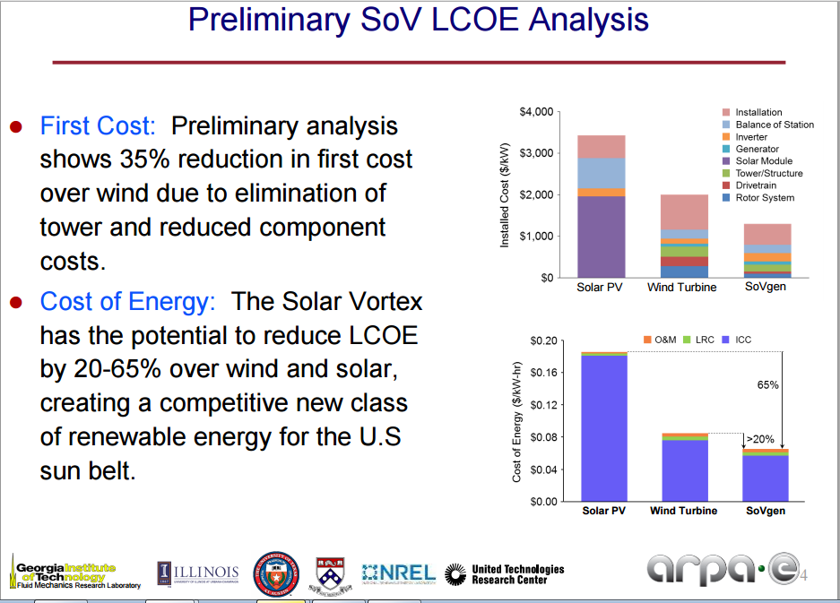

Slide 111
General:
Atmospheric water vapour content

Slide 113
Relative Humidity vs. Absolute Water Content
The desert air has a low relative humidity, but the much more important absolute moisture content can be comparable to that of cooler, more temperate regions.
Notice that the absolute moisture content of the air is lower in winter than in summer. This is initially counterintuitive.

Slide 114
Atmospheric Water Content
It has been estimated that only 2% of the atmospheric water content is in the form of clouds. The remaining 98% is in the form of water vapour.
At 1% average water content, the lowest one kilometre of the atmosphere above the Australian continent contains in the region of 100 billion tonnes of water.
The flow of water through the atmosphere is coming to be recognized as “flying rivers.”

Slide 115
Geothermal energy

Slide 116
Geothermal Energy “Priming” of the Vortex Engine
Vortex Engines will have to be located, initially at least, far from population centres. There will be a powerful “not in my back yard” effect.
Geothermal energy is therefore an excellent candidate to prime the vortex engine process.
The Atmospheric Vortex Engine can work satisfactorily with low grade geothermal energy (<100ºC), whereas typical Rankine cycle power plant requires temperatures above 200ºC.
Hot sedimentary aquifers such as those of the Great Artesian basin and Otway basin are arguably the best sources for vortex engine priming energy as they have the advantage of being easily tapped with well-proven technology.
The Birdsville geothermal power station plant derives its energy from the near-boiling (98ºC) water taken from the Great Artesian Basin at a relatively modest depth of 1230m.

Slide 117
Geothermal Energy Economics
Best fit curve
(source: A Comparison of Geothermal with Oil & Gas Well Drilling Costs – MIT Feb 2006)

Slide 118
From the drilling cost graph, it can be seen that because of the power law on the drilling cost curve, the economics are radically improved by using shallower bores. Alternatively an otherwise uneconomic geothermal field can be tapped closer to the end use point, dramatically reducing transmission costs. For instance the Cooper basin field in Australia is around a thousand kilometres from the end use point. Transmission capital costs are typically in the order of $1 million per kilometre, hence adding around $1 billion to the cost of a typical power station.
It should be noted that drilling costs are expected to be very substantially reduced with the development of new drilling technologies.
In the worst case, the infrastructure cost of geothermal priming energy for a 1 GW system (~200 MWe output) could be in the region of $100 million. Note that the geothermal energy does not have to meet the whole energy input, as there is a significant level of enthalpy available in the atmosphere, even in winter (see slide 45).
In a less optimal geothermal region, the cost could be higher, but the power transmission cost would normally be much lower. New drilling methodologies are being developed which promise to very significantly reduce the cost of deep drilling.

Slide 119
Precipitation

Slide 120
How much precipitation can be expected?
A 200 MW_{e} vortex engine is expected to generate around 12 thousand tonnes of precipitation per day, assuming 1% atmospheric water content and evaporation losses of up to 50% in falling to earth.
If the vortex engines were installed at 10 km centres, this would theoretically yield around 50 mm per annum. There is some reason to believe this may be amplified by natural processes =>>

Slide 121
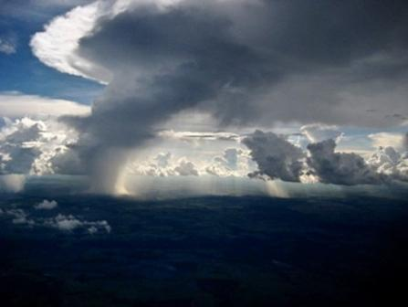
Flying Rivers
Sunlight pours around a "flying river"— a vast, humid air current over the Amazonian rain forest
Photograph courtesy Gérard Moss, Flying Rivers Project

Slide 122
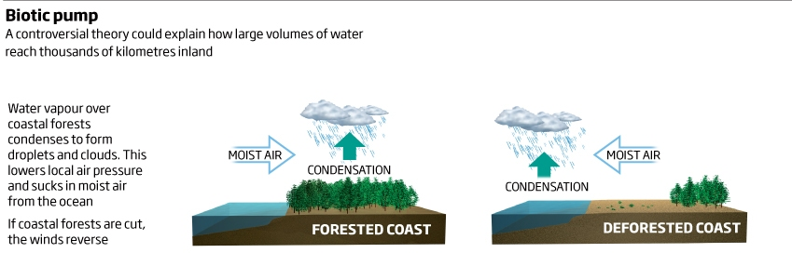
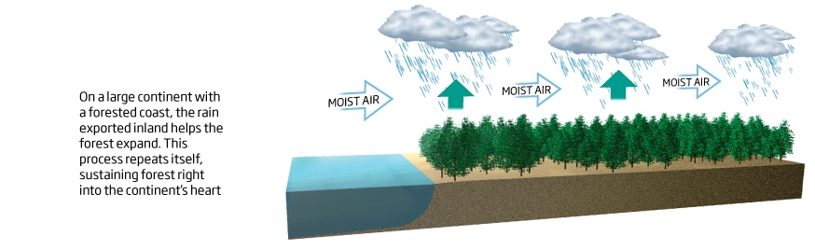
Forest Rainfall Generation
Ref: New Scientist April 1, 2009 http://www.newscientist.com/article/mg20227024.400-rainforests-may-pump-winds-worldwide.html

Slide 123
Forest Rainfall is Related to the Vortex Engine Precipitation
“...How can forests create wind? Water vapour from coastal forests and oceans quickly condenses to form droplets and clouds… the gas [from this evaporation] takes up less space as it turns to liquid, lowering local air pressure. Because evaporation is stronger over the forest than over the ocean, the pressure is lower over coastal forests, which suck in moist air from the ocean. This generates wind that drives moisture further inland. The process repeats itself as the moisture is recycled in stages, moving towards the continent’s heart. As a result, giant winds transport moisture thousands of kilometres into the interior of a continent.
The volumes of water involved in this process can be huge. More moisture typically evaporates from rainforests than from the ocean. The Amazon rainforest, for example, releases 20 trillion litres [20 billion tonnes] of moisture every day.
‘In conventional meteorology the only driver of atmospheric motion is the differential heating of the atmosphere. That is, warm air rises,” Makarieva and Gorshkov told New Scientist. But, they say, “Nobody has looked at the pressure drop caused by water vapour turning to water...’”
New Scientist 01 April 2009
Refer also: Precipitation on land versus distance from the ocean: Evidence for a forest pump of atmospheric moisture; A.Makarieva, V.Gorshkov and Bai-Lian Li; ScienceDirect 10 Jan 2009.

Slide 124
We are Turning the Amazon into a Desert!
http://blog.cifor.org/26559/the-science-is-clear-forest-loss-behind-brazils-drought?fnl=en
The science is clear: Forest loss behind Brazil’s drought
http://www.theecologist.org/News/news_analysis/2776099/without_its_rainforest_the_amazon_will_turn_to_desert.html
Without its rainforest, the Amazon will turn to desert
60% OF EARTH'S HEAT TRANSFER TO SPACE TAKES PLACE THROUGH MOIST CONVECTION
http://www.atmos.washington.edu/~dargan/587/587_3.pdf

Slide 125
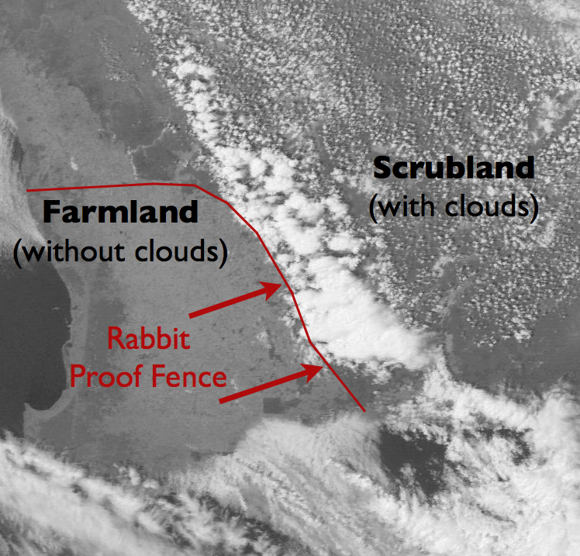
The rabbit-proof fence in Western Australia was completed in 1907 and stretches about 3,000 km. It acts as a boundary separating native vegetation from farmland. Within the fence area, scientists have observed a strange phenomenon: above the native vegetation, the sky is rich in rain-producing clouds. But the sky on the farmland side is clear.
https://www.eol.ucar.edu/content/research-goals-objectives

Slide 126
The Consequences of Land Clearing
“…Within the last few decades, about 32 million acres of native vegetation have been converted to croplands west of the [rabbit proof] fence. On the agricultural side of the fence, rainfall has been reduced by 20 percent since the 1970s.”
“Dr. Nair speculates that increases in the world’s population will prompt the clearing of more land to increase food production. But he wonders whether, in the long run, “we will reach a point of land clearing that will diminish food production,” because rainfall has decreased.”
http://www.nytimes.com/2007/08/14/science/earth/14fenc.html?_r=4&oref=slogin&oref=slogin&oref=slogin&

Slide 127
Evaporation of Water at the Sea–Atmosphere Interface
The vortex engine is theoretically most effective near the equator, due to a combination of high temperatures and humidity.
To enable the Vortex Engine to achieve maximum efficiency at mid to higher latitudes, local humidity has to be increased. Others have looked at this before:
  ...However the evaporation of water from the sea surface is slow and inefficient because of the need for large amounts of latent heat and because the perpendicular component of turbulence in the air vanishes at the surface leaving a stagnant humid layer (Csanady 2001). The wind has to blow over thousands of kilometres of warm sea before it can bring rain. Saudi Arabia is dry because the Red Sea and the Persian Gulf are narrow. Chile is dry because the Humboldt current is cold...
http://www.mech.ed.ac.uk/research/wavepower/rain%20making/shs%20rain%20paper%20Feb.pdf
The proposed mechanism to attain this is shown in the next slide.

Slide 128
Evaporation of Seawater at Coast
Offshore wind
Freshwater rain
Salty rain
Humid air
Humidification due to partial evaporation of rain
Multiple land-based vortex engines, optimised for power generation
Multiple offshore vortex engines located ca 20 – 50 km from coast, using geothermal energy to evaporate seawater, and optimised for generation of water vapour
Hot rocks (low grade geothermal energy)

Slide 129
The Desertification of Australia
There is evidence that the desertification of much of Australia coincided with the replacement of fire-tender rainforest with fire-resistant sclerophyll forest about a hundred thousand years ago. This may have been due to increased lightning strikes with climate change, or the arrival of Man:
  “For a specific example Makarieva and Gorshkov point to prehistoric Australia. They believe the pump ‘explains the enigmatic conversion of Australian forests to deserts that roughly coincides in timing with the appearance of the first people.’ ”
  “According to Makarieva and Gorshkov, when these early peoples burned small bands of forests along the coast where they first inhabited, ‘The internal inland forests were cut off from the ocean (the tube of the pump cut off) and underwent rapid desertification.’ ”
  “Simply put a loss of coastal forests—which had been driving rain from the ocean into the interior—caused Australia's current dry climate. If Australia hadn't lost those coastal forests, its environment may be entirely different today—and would not be suffering from extreme and persistent droughts.”
  Source: Mongabay.com, 1 April 2009

Slide 130
The Desertification of Australia
This thesis is supported in Fire: The Australian Experience :
  “Some scientists believe that this dramatic increase in charcoal is due to fires deliberately started by people, and that the changes in vegetation cannot be explained just in terms of climate changes. This is because, at this site, there had been little change in vegetation before this, despite significant fluctuations in climate in North Eastern Australia. In addition to this there was a continuous charcoal record throughout all samples, indicating that there would always have been some naturally occurring fire in the environment and this also had little effect on the environment. Evidence of this kind has been used to support the theory that Aborigines were living in Australia well before the generally accepted figure of 40,000 years ago.”
http://www.rfs.nsw.gov.au/file_system/attachments/State/Attachment_20050308_44889DFD.pdf
Also see Arid Australian interior linked to landscape burning by ancient humans http://www.eurekalert.org/pub_releases/2005-01/uoca-aai012505.php
Early Man can be excused because of ignorance, but today we know what we are doing. Thus rainforests such as those of Amazonia and Borneo may also be vulnerable to destruction by the actions of Man: see the details in
http://www.unep.org/pdf/GEOAMAZONIA.pdf .
This report discusses the future of the Amazon, including the potential impact of climate change. It warns that the combination of climate change and deforestation for farming could destroy half the Amazon within 20 years.

Slide 131
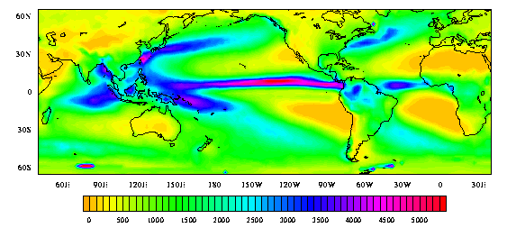
Enhanced Precipitation over Land
Rainfall (mm)
The use of vortex engines cannot increase global precipitation, but in conjunction with forests, it should be able to enhance its distribution. It can be seen above that maritime regions are currently strongly favoured.

Slide 132
Peak Water
The concept of peak oil is well known. Somewhat less well known is that fact that we are “mining” fresh water supplies much faster than they can be replenished:
  “...In some regions, water use exceeds the amount of water that is naturally replenished every year. About one-third of the world’s population lives in countries with moderate-to-high water stress, defined by the United Nations to be water consumption that exceeds 10 percent of renewable freshwater resources. By this measure, some 80 countries, constituting 40 percent of the world’s population, were suffering from water shortages by the mid-1990s (CSD 1997, UN/WWAP 2003). By 2020, water use is expected to increase by 40 percent, and 17 percent more water will be required for food production to meet the needs of the growing population. According to another estimate from the United Nations, by 2025, 1.8 billion people will be living in regions with absolute water scarcity, and two out of three people in the world could be living under conditions of water stress (UNEP 2007)....”
From M.Palaniappan and P.H. Gleick in http://www.worldwater.org/data20082009/ch01.pdf, 2006.
We have a vicious circle in that population pressures are causing deforestation and hence degradation of the “forest pumping” effect. The vortex engine can help to “kick start” this process again.

Slide 133
Infra red absorptivity

Slide 134
The Vapor Field as Solar Collector
O
H
H
Multi-atomic molecules such as carbon dioxide and water vapor are efficient absorbers of infra-red radiation

Slide 135
Absorption of Infra-Red Radiation
“…compared to molecular nitrogen and oxygen, water vapor molecules are capable of great gymnastic feats. Besides being able to stretch and compress, they can bend at their mid-sections, rotate, and perform combinations of stretching, bending and rotating. Because they can move in such complex ways, they can absorb and emit much more radiation than molecules that consist of only two atoms… Changes in energy state of a single molecule are communicated to neighboring molecules with which it collides… Absorption of radiation… increases air temperature…”
Professor Kerry Emanuel MIT
Thus the water and vapour field associated with a large forest is an efficient solar collector in its own right. The solar energy is stored as the high enthalpy inherent in warm humid air. Most of this enthalpy is in the form of the latent heat of vaporisation of water, and this energy can be utilized within the vortex engine. Hence the engines should ideally be utilized synergistically with forests, helping to modify the local, and on a large enough scale global, climate.

Slide 136
FAQs

Slide 137
What are the advantages of
Convective Vortex Systems?
Reduced CO₂ emissions
Zero fossil fuel use – instead utilization of stored solar energy within atmospheric water vapour and air
Increased precipitation over land means increased plant growth and subsequent photosynthesis – hence natural sequestration of CO₂
Increased heat radiation to space – hence global cooling
Significantly increased terrestrial Albedo
Reduction in atmospheric water vapour levels as precipitation enters the groundwater and eventually the sea – reduction in the most important greenhouse gas

Slide 138
Why Won’t it Run Away?
The humidity of the surrounding field would be kept below the critical level at which the vortex would be self-sustaining. Only after passing geothermal hot water/steam through the vortex engine heat exchangers would the energy level become super-critical. The air temperature would be in the region of 40 – 50 Celsius above ambient.
The “boundary layer fence” would act to quarantine the vortex from the surrounding boundary layer, except for allowing the flow of air through the control dampers and turbines.
The most ideal location for the vortex engine would be near the Equator (the intertropical convergence zone) where wind is relatively infrequent.

Slide 139
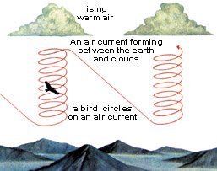
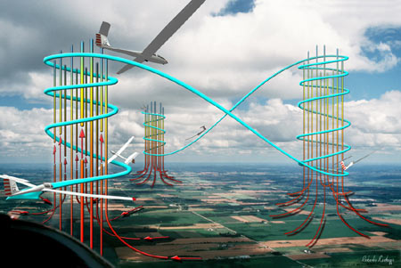
Thermals
Birds have been extracting energy from thermal updrafts for millions of years. Glider pilots have been copying them for about eighty years and we take this for granted.
With some not particularly high-tech engineering, much higher energy can be extracted via vortex engines. It is envisaged that the vortex engines would be interconnected within a power grid. If high cross winds were experienced in one area, local generators would be closed down and power imported from another part of the grid.
There are also very large areas of the Earth’s surface (particularly the intertropical convergence zone, or doldrums) where winds are always negligible or low.

Slide 140
The Stability of Thermals
Thermal updrafts associated within heat sources are stable in terms of both space and time.
Crosswinds act to reduce the strength of the updraft by causing turbulent mixing with the surrounding atmosphere.
There is no reason to believe that the updraft plume from the vortex engine would be any different.

Slide 141
What Sort of Power Will Be Produced?
Based on a total power similar to an average tornado (1 GW expended) and an overall system efficiency of around, say, 20%, a power output of 200 MW could be expected per engine.
For the GaTech proposal, each 10m module is projected to produce 50kW.

Slide 142
What will it Cost?
Based on extrapolation from dry cooling tower costs, a 200 MWe plant could be expected to cost in the order of $500 million. There are many unknowns at this stage, but this estimate is probably conservatively high.
This would compare favourably with that for Enviromission’s 200 MWe solar power tower prototype, which is expected to cost in the region of $750 million, or a conventional geothermal power station of the same output which would cost around $800 million, before power transmission costs were factored in.

Slide 143
Won’t large numbers of Vortex Engines disrupt normal atmospheric circulation?
The Vortex Engine can be arranged to have either clockwise or anticlockwise rotation:
  “Tornadoes normally rotate cyclonically (when viewed from above, this is counterclockwise in the northern hemisphere and clockwise in the southern). While large-scale storms always rotate cyclonically due to the Coriolis effect, thunderstorms and tornadoes are so small that the direct influence of the Coriolis effect is unimportant, as indicated by their large Rossby numbers...”
  Wikipedia

Slide 144
Where Would It Work Best?
Regions
Tropical regions with good geothermal resources such as Indonesia, Bangladesh and the Philippines and high CAPE (convective available potential energy) – the inter tropical convergence zone
Arid or semi-arid regions such as Australia, the Arabian Peninsula, Turkey, Palestine and southern and northern Africa
Along arid regions with good geothermal resources such as Afghanistan, Tibet, northern India, Pakistan, Jordan, Ethiopia and Nepal
South western USA and northern Mexico
Offshore north-western Europe - Britain and the Netherlands reportedly have the highest frequency of tornadoes per unit area on Earth, although of relatively low intensity
Offshore China and Japan (geothermal resources and high CAPE)
Ideal Conditions
Low crosswinds
High CAPE (convective available potential energy)
Geothermal energy availability
Currently arid or semi arid (to make use of enhanced precipitation)

Slide 145
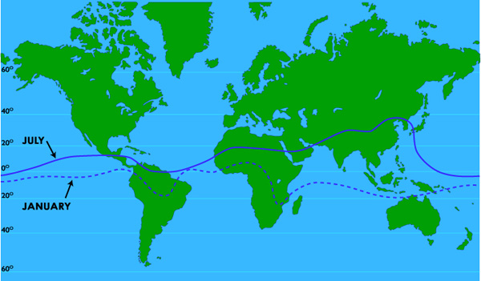
“Stuck in the Doldrums” – the Intertropical Convergence Zone (ITCZ)
“The Intertropical Convergence Zone, is the region that circles the Earth, near the equator, where the trade winds of the Northern and Southern Hemispheres come together. The water in the equator is warmed by the intense sun which in turn heats the air in the ITCZ, raising its humidity and making it buoyant.”

Slide 146
ITCZ - “The Doldrums” – perfect for the vortex engine
“Aided by the convergence of the trade winds, the buoyant air rises. As the air rises it expands and cools, releasing the accumulated moisture in an almost perpetual series of thunderstorms.”
The Dreaded Belt of Calm
“Early sailors named this belt of calm “the Doldrums” because of the inactivity and stagnation they found themselves in after days of no wind. In an era when wind was the only effective way to propel ships across the ocean, finding yourself in the Doldrums could mean death…”
https://blog.mytimezero.com/2014/01/10/stuck-in-the-doldrums-the-intertropical-convergence-zone/
This combination of high Convective Available Potential Energy (CAPE) and low crosswind is ideal for the operation of the vortex engine.

Slide 147
The Asian Brown Cloud
“The Asian brown cloud is created by a range of airborne particles and pollutants from combustion (e.g., woodfires, cars, and factories), biomass burning and industrial processes with incomplete burning. The cloud is associated with the winter monsoon (November/ December to April) during which there is no rain to wash pollutants from the air.”
Wikipedia
The Asian Brown Cloud is closely associated with the Inter Tropical Convergence Zone.

Slide 148
The Asian Brown Cloud
Atmospheric brown clouds: Impacts on South Asian climate and hydrological cycle
Increase in aerosols can nucleate copious amounts of small droplets, which can inhibit the formation of larger raindrops and decrease precipitation efficiency (33). This microphysical effect can suppress rainfall in polluted regions (5) and add to the rainfall decreases simulated in the present study.
There has been a steady increase of drought frequency from the 1930s, which peaked in the 1980s (Fig. 7), with decrease in average rainfall after the 1960s. The drought frequency abated during the 1990s (30), but the decadal rainfall was still less than normal. During 2001–2004, two droughts have already occurred, and the average rainfall for this decade so far is 9% below normal. These negative trends lead us to speculate whether the ABC is indeed appearing to show its impact as guided by our modelling results, even though there may be other causes such as El Niño–Southern Oscillation–monsoon (32, 34) interactions or natural variations in other slowly varying boundary conditions such as land-surface moisture, Eurasian snow cover, and others (34).
ABCs have such a large effect on the monsoon primarily because the forcing simultaneously impacts many components of the monsoon system, including the solar heating of the surface–atmosphere system, the SST gradient, the convective instability of the troposphere, evaporation, and the Hadley circulation, which are factors that have fundamental influences on the monsoon rainfall (25, 30, 31, 34).

Slide 149
The Atmospheric Brown Cloud
“…The increase in atmospheric stability and the reduction in rainfall are important aspects of the air pollution impacts on climate. Both these effects can enhance the lifetime of aerosols because increases in low-level inversion (see Fig. 4) can increase the persistence of brownish haze layers, and reduction in rainfall can decrease the washout of aerosols. Such feedback effects should be included in future studies to understand the full impact of the ABCs on South Asia. Of particular concern is the reduction in monsoon rainfall in India because in South Asia there is a strong positive correlation between food production and precipitation amount (35). In addition, availability of fresh water is a major issue for the future (36). Even with the forcing fixed at 1998 values, the rainfall decrease in India continues to worsen beyond 1998 (Fig. 3B ). The impact of the ABC on monsoon rainfall, in conjunction with the health impacts of air pollution (37), provides a strong rationale for reducing air pollution in the developing nations.”
“However, a sudden reduction in air pollution without a concomitant reduction in global GHGs also can accelerate the warming in South Asia because, according to the present simulations, ABCs have masked as much as 50% of the surface warming due to GHGs.”
http://www.pnas.org/content/102/15/5326.full

Slide 150
Another source
“...White sulfur aerosols cool the climate; black carbon soot warms the climate. So when you mix the two kinds of aerosol pollution up in the Asian brown cloud, one would expect climate effects to even out. Unfortunately in our physical world things are never that simple.”
COOLING ON GROUND, WARMING IN AIR
“The reason the reflective (light) and absorbing (dark) aerosols in the brownish mix do not compensate each other’s effects, is that they both block sunlight - so they both lead to cooling on the surface directly beneath the haze, which is thickest over the north of India, including the Ganges Basin. As darker-coloured soot aerosols are dominant in the mix higher up in the atmosphere, energy absorption outweighs solar reflection - so the brown haze leads to net atmospheric warming.”
“When you have warm air up high and cooler temperatures on the ground, you create what meteorologists call a stable atmosphere, with suppressed convection, and little precipitation. Higher air pressure at the surface makes the brown haze block the monsoon …”
http://www.bitsofscience.org/indian-monsoon-climate-change-3470/

Slide 151
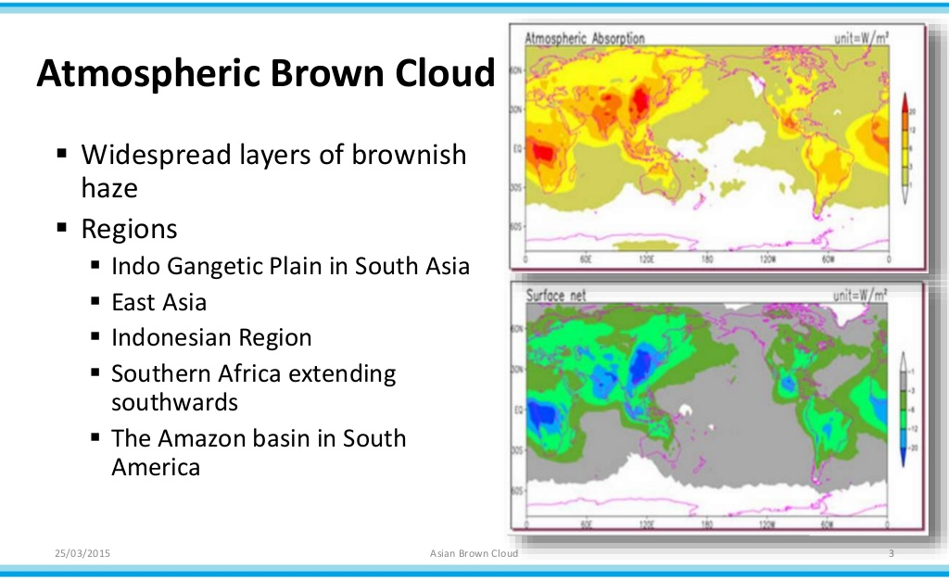
http://www.slideshare.net/srujanirulzzworld/asian-brown-cloud

Slide 152
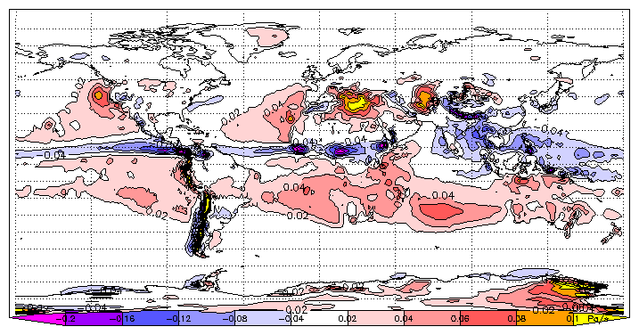
Intertropical Convergence Zone
Vertical air velocity at 500 hPa, July average. Ascent (negative values) is concentrated close to the solar equator; descent (positive values) is more diffuse
https://en.wikipedia.org/wiki/Intertropical_Convergence_Zone#/media/File:Omega-500-july-era40-1979.png

Slide 153
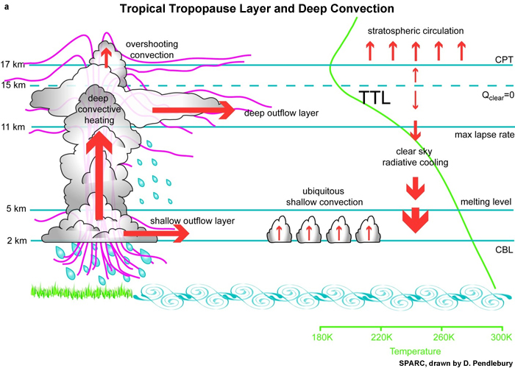
Lapse rate within “brown cloud.” (Exaggerated)
The ITCZ
Vortex updraft
The inhibition created by the ABC can easily be overcome by the strong vortex updraft

Slide 154
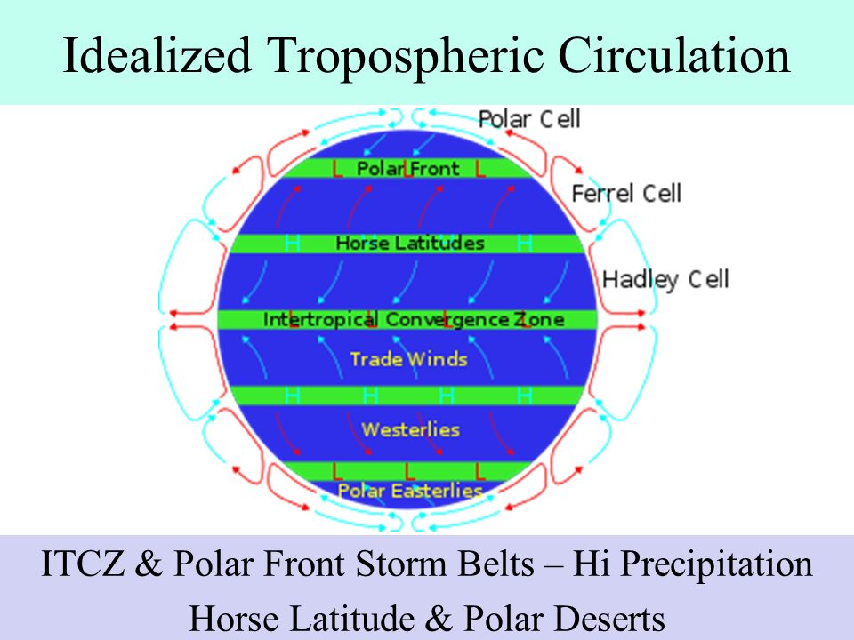

Slide 155
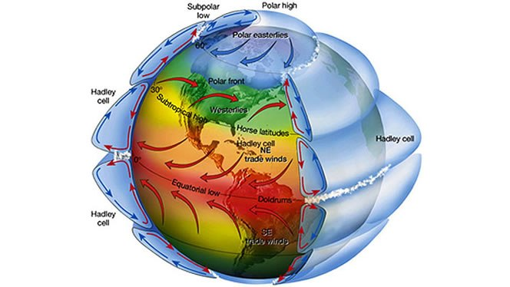
Over 50% of Earth’s heat radiation to Space takes place from the upper layers of the Hadley cell
ITCZ
Efficient operation of the Hadley cell is crucial for Earth’s heat budget!

Slide 156
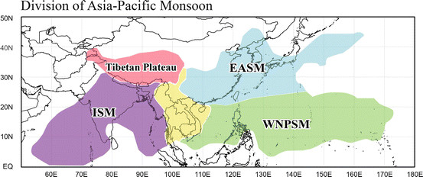
Asian Summer Monsoons

Slide 157

East Asian Summer Monsoon is weakening
The north of China gets 60 – 70% of its precipitation from the monsoon

Slide 158
Global Monsoons are weakening

Slide 159
China’s water supply
…China’s disadvantage, compared with the United States, is that it has a smaller water supply yet almost five times as many people. China has about 7 percent of the world’s water resources and roughly 20 percent of its population. It also has a severe regional water imbalance, with about four-fifths of the water supply in the south...
Tough political choices… seem unavoidable. Studies by different scientists have concluded that the rising water demands in the North China Plain make it unfeasible for farmers to continue planting a winter crop.

Slide 160
China’s water supply
…[If] China became an ever bigger customer on world grain markets... grain prices could steadily rise, contributing to inflation and making it harder for other developing countries to buy food.
The social implications would also be significant inside China. Near Shijiazhuang… [farms] depend on wells that are more than [200 metres] deep. Not planting winter wheat would amount to economic suicide.
http://www.nytimes.com/2007/09/28/world/asia/28water.html

Slide 161
Where would the system best be located?
Sedimentary aquifer geothermal resources
http://www.curtin.edu.au/research/cusp/local/docs/geothermal-oldmeadow-marinova.pdf

Slide 162

Hot sedimentary aquifer example
Gnangara mound north of Perth, Western Australia
Total sustainable yield approximately 200 MW_{th}

Slide 163
How high would the vortex need to be?
For maximum precipitation, the top of the vortex should be towards the top of the troposphere (ref Emanuel chart slide 23)
As the Carnot efficiency is a function of temperature differential, again, higher altitudes will give higher efficiencies
In general, the system should aim to achieve altitudes above about five kilometres. The solar updraft tower with a one kilometre high stack can only achieve an efficiency in the order of 3%

Slide 164

The Carnot Potential Wind Speed
Map showing the maximum wind speed in MPH achievable by tropical cyclones over the course of an average year according to Carnot’s theory of heat engines.
Source: Divine Wind by MIT Professor Kerry Emanuel

Slide 165
How can a small-scale prototype be built?
The prototype should arguably be energised by the following:
Utilisation of waste gases from industrial processes, particularly those containing high water vapour content
Injection of high velocity gases into a vortex chamber
This would facilitate demonstration of the principle of the updraft vortex, while eliminating the need for a relatively expensive heat exchange system.

Slide 166
Sketch of “20 metre” prototype
Sketch
φ 20 m.
9.2 m. centres.
X
Vortex chamber height ~ 7m.

Slide 167

Sketch of 20 metre prototype

Slide 168
Proposed Exemplar
A particular waste gas on the downstream side of a wet scrubber in an extractive metallurgical plant in the writer’s experience had the following characteristics:
  Temperature 82ºC
  Water vapour content ~22%/w
  CO₂ 10%
  Exit velocity from induced draft fan 40 m/s
  Approximate volumetric flow rate 40 m³/s
  Approximate energy flux 25 MW
  Gas stream fluid power 500 kW
This would be ideal for use as feedstock for a 20 metre diameter vortex engine prototype.
The prototype would primarily be useful to demonstrate the feasibility of dispersal of waste gases from process and power plant stacks with power generation as a bonus.

Slide 169
Prototype projected cost
The cost of such a prototype would vary considerably with the location in which it was built.
A rough estimate for China would be in the region of around US$1 million dollars, assuming that the heat input for, say, a year’s research comes free of charge in the form of waste vapour and gas, and that the fan is available from existing plant.

Slide 170
Vortex Engine: General Conclusion
The increasing severity of tropical cyclones and tornadoes in some regions is arguably a pointer to Earth’s need to dump heat to Space.
That’s fine, but we need to learn to control the location, frequency and intensity of the process… hence the need for vortex engine research

Slide 171
Climate Change
The following text is extracted from MIT Professor Kerry Emanuel's book "What We Know About Climate Change," published in 2007. It appears to be apposite to the current situation:
The global mean temperature is now greater than at any time in at least the past 500 to 1,000 years...
Rainfall will continue to become concentrated in increasingly heavy but less frequent events.
The incidence, intensity, and duration of both floods and drought will increase.
The intensity of hurricanes will continue to increase, though their frequency may dwindle.
All these projections depend, of course, on how much greenhouse gas is added to the atmosphere over the next century, and even if we could be certain about the changes, estimating their net effect on humanity is an enormously complex undertaking, pitting uncertain estimates of costs and benefits against the costs of curtailing greenhouse-gas emissions. But we are by no means certain about what kind of changes are in store, and we must be wary of climate surprises.
Even if we believed that the projected climate changes would be mostly beneficial, we might be inclined to make sacrifices as an insurance policy against potentially harmful surprises.

Slide 172
Harnessing the vortex principle will not be easy, and the risks are significant.
On the other hand there is a strong argument that research must be carried out to determine its viability:
“[Global warming is] perhaps the most consequential problem ever confronted by Mankind. Like it or not, we have been handed Phaeton’s reins, and we will have to learn how to control climate if we are to avoid his fate.”
Professor Kerry Emanuel

Slide 173
End

