Slide 1
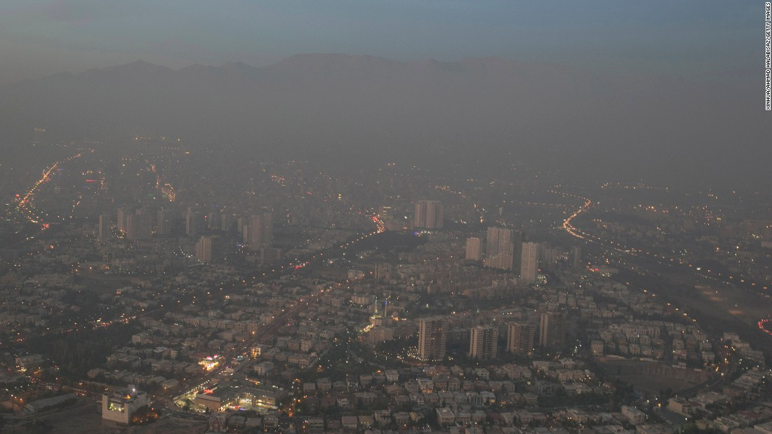
THE URGENCY FOR THE VORTEX ENGINE TO SOLVE THE MIDDLE EAST, ASIAN AND NORTH AFRICAN ENERGY AND WATER CRISES
TEHERAN

Slide 2
Problems with natural tropospheric convection
  “Study: Warmer World Will Produce Fewer Clouds” January 03, 2014
  http://www.voanews.com/content/study-warmer-world-will-produce-fewer-louds/1822952.html
  Steven Sherwood, a climate scientist at Australia's Centre of Excellence for Climate System Science and lead author of the report, says the prediction of a 4º Celsius global warming is based on the role of water vapour in cloud formation:
  “What we see in the observations is that when air picks up water vapour from the ocean surface and rises up, it often only rises a few kilometres before it begins its descent back to the surface," Sherwood said. "Otherwise it might go up 10 or 15 kilometres. And those shorter trajectories turn out to be crucial to giving us a higher climate sensitivity because of what they do to pull water vapour away from the surface and cause clouds to dissipate as the climate warms up.”
  (Emphasis added)
The Atmospheric Brown Cloud is acting to significantly inhibit convection, particularly in the tropics where it is reduced by up to 15%.

Slide 3
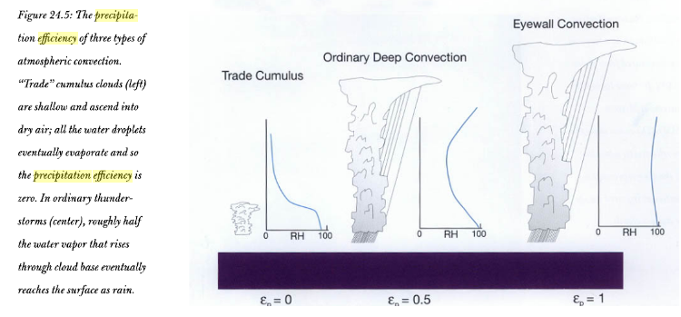
With eyewall convection within a cyclone, the precipitation efficiency is typically 100%
Divine Wind: The History and Science of Hurricanes
By Kerry Emanuel

Slide 4
What this means
reflection to Space
-70ºC
tropopause
evaporation
precipitation
=> Increased tropospheric humidity
=> Reduced tropospheric humidity
convection
Earth
Sea
Non-rotating updrafts lead to global warming.
Rotating updrafts reduce global warming.

Slide 5
Waterspout
https://www.youtube.com/watch?v=KUaOOaTE2Fg

Slide 6
Ramifications
With modest convection updraft velocities, heat loss from the updraft plume via radiation and mixing may be excessive, leading to:
Ineffective or incomplete convective heat transfer through the troposphere.
Mid-level clouds. The subsequent evaporation of the clouds boosts the build-up of atmospheric water vapour.
Note that water vapour is the planet’s most important greenhouse gas
The high updraft efficiency typical of vortex flow leads to:
High level reflective clouds
High precipitation efficiency, hence removal of water vapour from the atmosphere
The vortex engine is designed to initiate and maintain this vortex updraft mechanism

Slide 7
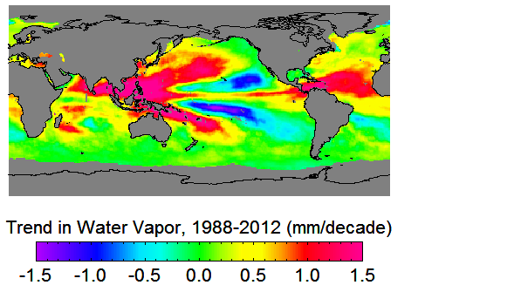
Trends in Water Vapour 1988-2012
http://www.remss.com/research/climate
mm/decade

Slide 8

Sea temperatures are rising
http://www.atmos.washington.edu/~dargan/587/587_3.pdf

Slide 9
Where Would The Vortex Engine Work Best?
Regions
Tropical regions with good geothermal resources such as Indonesia, Bangladesh, the Philippines, the Middle East, rift valley Africa and high CAPE (Convective Available Potential Energy) – e.g. the inter tropical convergence zone
Arid or semi-arid regions such as Australia, the Arabian Peninsula, Turkey, Palestine and southern and northern Africa
Along arid regions with good geothermal resources such as the Red Sea, Persian Gulf, Afghanistan, Tibet, northern India, Pakistan, Jordan, Ethiopia and Nepal
South western USA and northern Mexico
Offshore north-western Europe - Britain and the Netherlands reportedly have the highest frequency of tornadoes per unit area on Earth, although of relatively low intensity
Offshore Japan and China (geothermal resources and high CAPE)
Ideal Conditions
Low crosswinds
High CAPE
Geothermal energy availability
Currently arid or semi arid (to make use of enhanced precipitation)

Slide 10
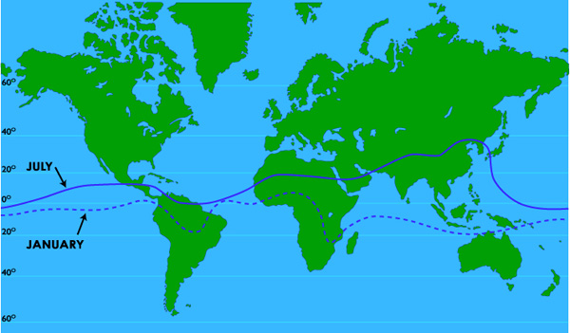
“Stuck in the Doldrums” – the Intertropical Convergence Zone (ITCZ)
“The Intertropical Convergence Zone, is the region that circles the Earth, near the equator, where the trade winds of the Northern and Southern Hemispheres come together. The water in the equator is warmed by the intense sun which in turn heats the air in the ITCZ, raising its humidity and making it buoyant.”
(i.e. High convective available potential energy – CAPE)

Slide 11
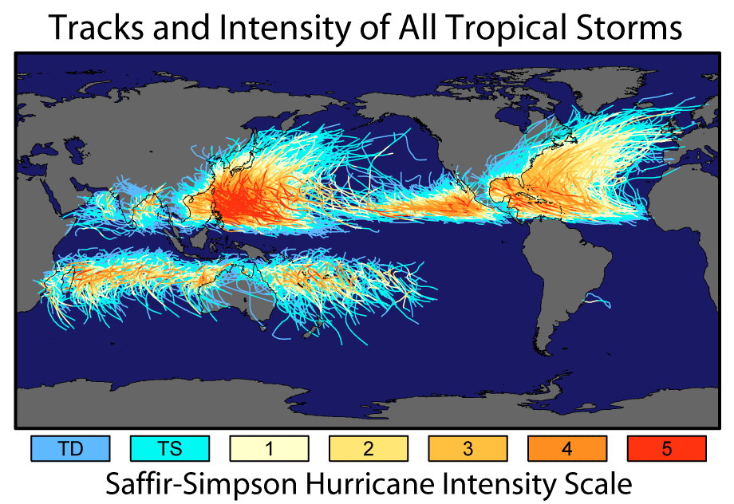
http://www.goes-r.gov/users/comet/tropical/textbook_2nd_edition/navmenu.php_tab_9_page_1.0.0.htm
Cyclones are not naturally generated at the equator because of the lack of a Coriolis effect.
The vortex engine can easily fix this problem by imparting the required vorticity.

Slide 12
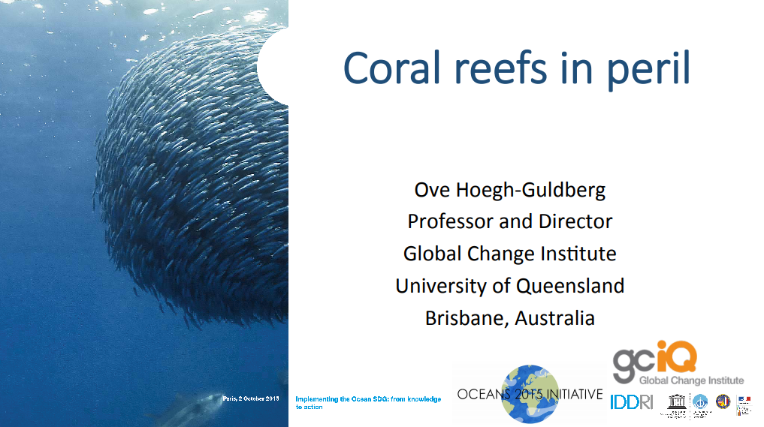
Coral Bleaching

Slide 13
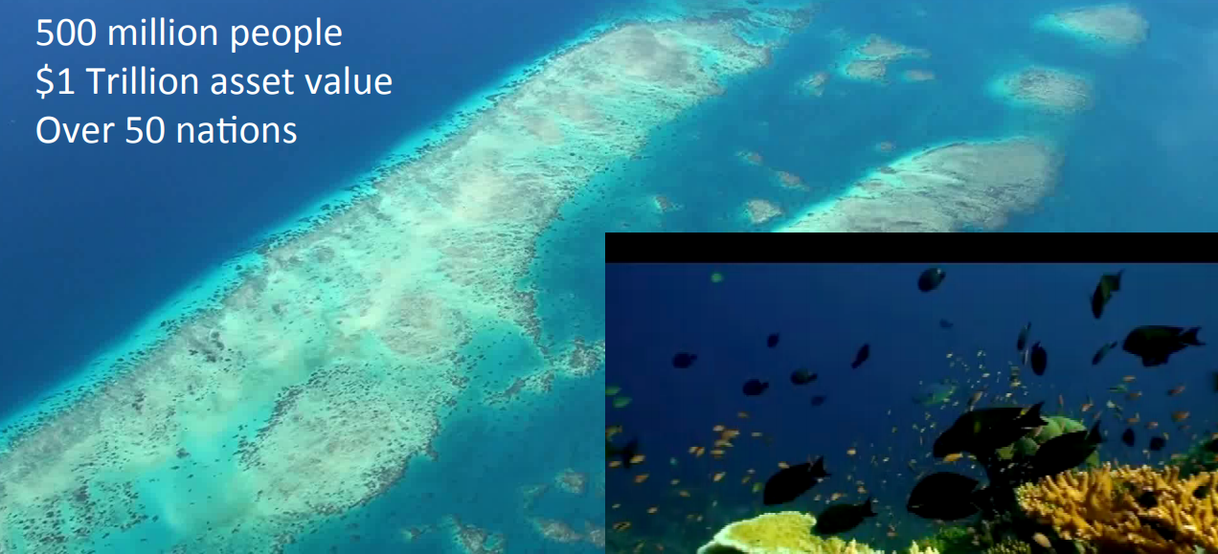
Coral Bleaching
http://www.iddri.org/Evenements/Conferences-internationales/15.10.02_conf%20oceans%20sdg%20ppt%20Ove%20Guldberg.pdf

Slide 14
Coral Bleaching
So why will the loss of our Great Reefs cost the world one trillion dollars?
The coral reef’s monetary value comes from a 2015 report from the Director of University of Queensland’s Global Change Institute; Ove Hoegh-Guldberg.
The report highlights that the world’s coral reefs support 500 million people across 50 different countries.
The reefs are in great danger of being lost due to coral bleaching caused by increases in Sea SurfaceTemperature (SST).

Slide 15
ITCZ - “The Doldrums” – perfect for the vortex engine
“Aided by the convergence of the trade winds, the buoyant air rises. As the air rises it expands and cools, releasing the accumulated moisture in an almost perpetual series of thunderstorms.”
The Dreaded Belt of Calm
“Early sailors named this belt of calm “the Doldrums” because of the inactivity and stagnation they found themselves in after days of no wind. In an era when wind was the only effective way to propel ships across the ocean, finding yourself in the Doldrums could mean death…”
https://blog.mytimezero.com/2014/01/10/stuck-in-the-doldrums-the-intertropical-convergence-zone/
This combination of high Convective Available Potential Energy (CAPE) and low crosswind is ideal for the operation of the vortex engine.

Slide 16
The Atmospheric Brown Cloud
“The Asian brown cloud is created by a range of airborne particles and pollutants from combustion (e.g., woodfires, cars, and factories), biomass burning and industrial processes with incomplete burning. The cloud is associated with the winter monsoon (November/ December to April) during which there is no rain to wash pollutants from the air.”
Wikipedia
The Asian Brown Cloud is now referred to as the Atmospheric Brown Cloud, as it occurs around the world and is closely associated with the Inter Tropical Convergence Zone.

Slide 17
The Atmospheric Brown Cloud (ABC)
Atmospheric brown clouds: Impacts on South Asian climate and hydrological cycle
http://www.pnas.org/content/102/15/5326.abstract
Increase in aerosols can nucleate copious amounts of small droplets, which can inhibit the formation of larger raindrops and decrease precipitation efficiency (33). This microphysical effect can suppress rainfall in polluted regions (5) and add to the rainfall decreases simulated in the present study.
There has been a steady increase of drought frequency from the 1930s, which peaked in the 1980s (Fig. 7), with decrease in average rainfall after the 1960s. The drought frequency abated during the 1990s (30), but the decadal rainfall was still less than normal. During 2001–2004, two droughts have already occurred, and the average rainfall for this decade so far is 9% below normal. These negative trends lead us to speculate whether the ABC is indeed appearing to show its impact as guided by our modelling results, even though there may be other causes such as El Niño–Southern Oscillation–monsoon (32, 34) interactions or natural variations in other slowly varying boundary conditions such as land-surface moisture, Eurasian snow cover, and others (34).
ABCs have such a large effect on the monsoon primarily because the forcing simultaneously impacts many components of the monsoon system, including the solar heating of the surface–atmosphere system, the SST gradient, the convective instability of the troposphere, evaporation, and the Hadley circulation, which are factors that have fundamental influences on the monsoon rainfall (25, 30, 31, 34).
SST = Sea Surface Temperature

Slide 18
The Atmospheric Brown Cloud
“…The increase in atmospheric stability and the reduction in rainfall are important aspects of the air pollution impacts on climate. Both these effects can enhance the lifetime of aerosols because increases in low-level inversion (see Fig. 4) can increase the persistence of brownish haze layers, and reduction in rainfall can decrease the washout of aerosols. Such feedback effects should be included in future studies to understand the full impact of the ABCs on South Asia. Of particular concern is the reduction in monsoon rainfall in India because in South Asia there is a strong positive correlation between food production and precipitation amount (35). In addition, availability of fresh water is a major issue for the future (36). Even with the forcing fixed at 1998 values, the rainfall decrease in India continues to worsen beyond 1998 (Fig. 3B ). The impact of the ABC on monsoon rainfall, in conjunction with the health impacts of air pollution (37), provides a strong rationale for reducing air pollution in the developing nations.”
“However, a sudden reduction in air pollution without a concomitant reduction in global GHGs also can accelerate the warming in South Asia because, according to the present simulations, ABCs have masked as much as 50% of the surface warming due to GHGs.”
http://www.pnas.org/content/102/15/5326.full

Slide 19
“...White sulfur aerosols cool the climate; black carbon soot warms the climate. So when you mix the two kinds of aerosol pollution up in the Asian brown cloud, one would expect climate effects to even out. Unfortunately in our physical world things are never that simple.”
COOLING ON GROUND, WARMING IN AIR
“The reason the reflective (light) and absorbing (dark) aerosols in the brownish mix do not compensate each other’s effects, is that they both block sunlight - so they both lead to cooling on the surface directly beneath the haze, which is thickest over the north of India, including the Ganges Basin. As darker-coloured soot aerosols are dominant in the mix higher up in the atmosphere, energy absorption outweighs solar reflection - so the brown haze leads to net atmospheric warming.”
“When you have warm air up high and cooler temperatures on the ground, you create what meteorologists call a stable atmosphere, with suppressed convection, and little precipitation. Higher air pressure at the surface makes the brown haze block the monsoon …”
http://www.bitsofscience.org/indian-monsoon-climate-change-3470/
So this is a further significant barrier to atmospheric convection.

Slide 20
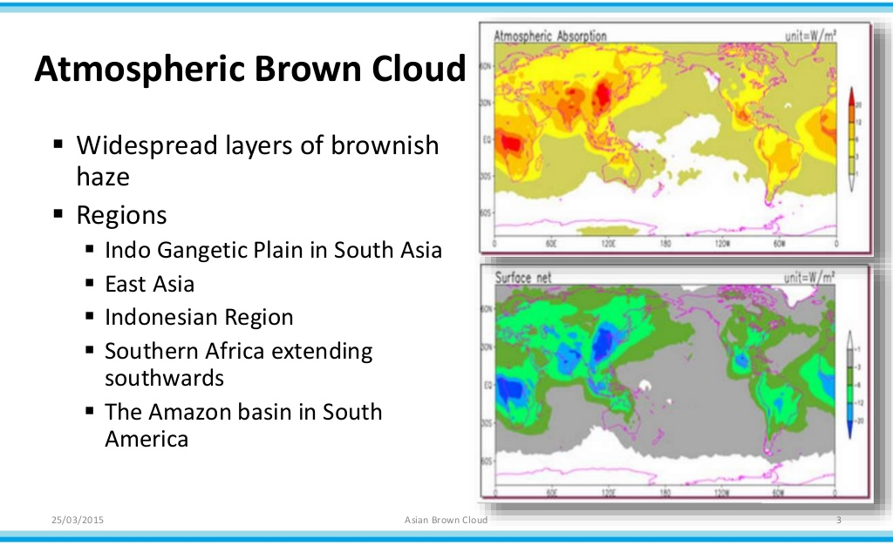
http://www.slideshare.net/srujanirulzzworld/asian-brown-cloud

Slide 21
Effect of South Asian Haze on Dry Season Surface Temperature and Rainfall
http://www.rrcap.ait.asia/abc/Documents/ABC_Report_2002_Full.pdf

Slide 22
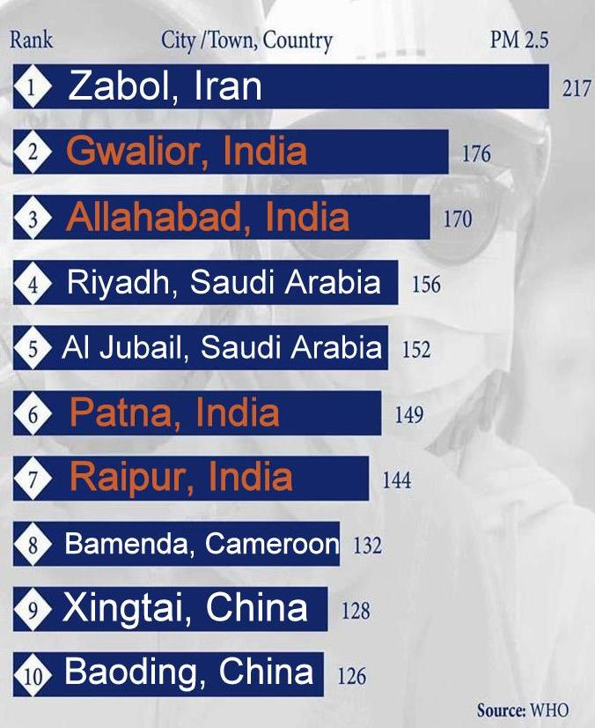
And you think Beijing is polluted?
The Chinese capital doesn’t make the top 10 list for world’s most polluted cities – and neither does Delhi. But nine cities in Asia do:
Subhra Priyadarshini
http://www.natureasia.com/en/nindia/article/10.1038/nindia.2016.165
The Middle East includes particulates from dust storms

Slide 23
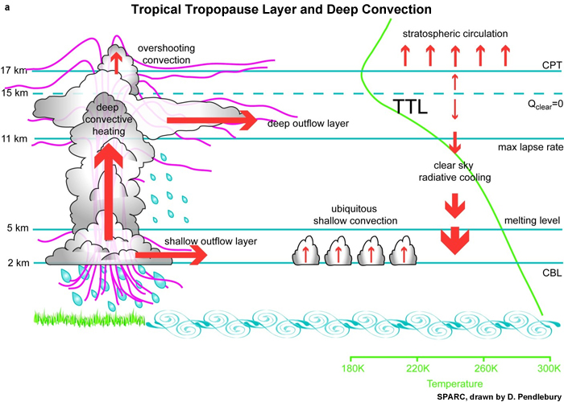
Reduced lapse rate in “brown cloud.” (Exaggerated)
The ITCZ
Notional vortex engine updraft temperature
The convective inhibition created by the ABC can easily be overcome by the vortex updraft

Slide 24
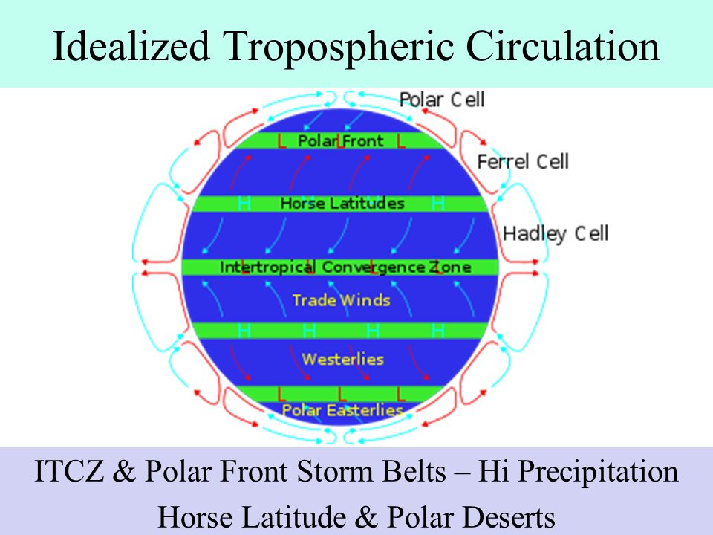

Slide 25
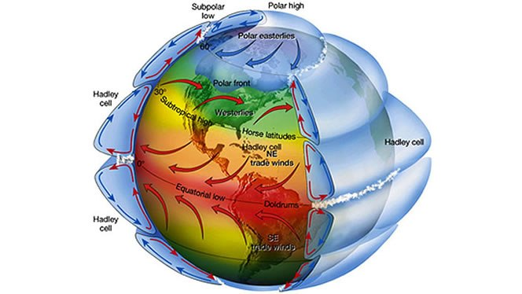
Over 50% of Earth’s heat radiation to Space takes place from the upper layers of the Hadley cell…
ITCZ
Efficient operation of the Hadley cell is crucial for Earth’s heat balance!

Slide 26
Where would the vortex engine systems best be located?
Sedimentary aquifer geothermal resources
http://www.curtin.edu.au/research/cusp/local/docs/geothermal-oldmeadow-marinova.pdf

Slide 27
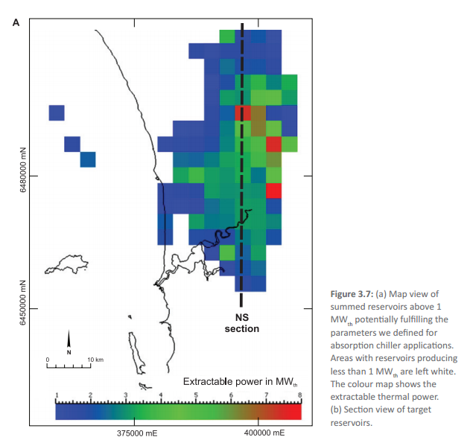
Hot sedimentary aquifer example
Gnangara mound north of Perth, Western Australia
Total sustainable yield approximately 200 MW_{th}

Slide 28
The Arabian peninsular (including the Persian Gulf and Red Sea) and that part of Asia within the ITCZ have excellent conditions for application of the vortex engine. These include:
  High convective available potential energy (CAPE)
  Good medium temperature geothermal resources
  Low crosswinds compared to temperate regions
  High sea surface temperatures

Slide 29
Will vortices work?
‘…Nilton Renno, a professor at the department of atmospheric, ocean and space sciences at the University of Michigan, has spent his career studying tornadoes and water spouts. He says there is no reason why [the] vortex engine wouldn’t work.’
Still, Renno isn't without reservations. He's particularly concerned about the ability to control such a powerful monster.
"The amount of energy involved is huge. Once it gets going, it may be too hard to stop," he says.
The Toronto Star, July 21 2007
“…‘The science is solid,’… ‘Once you induce circulation nearby, the vortex can be self-sustaining.’ ”
Discovery, Feb 28 2013
“…What’s necessary at this point is to do proofs of concept,” says professor Kerry Emanuel, the hurricane expert at MIT. “[The] idea is pretty simple and elegant. My own feeling is that we ought to be pouring money into all kinds of alternative energy research. There’s almost nothing to lose in trying this...”
ODE Magazine, March 2008

Slide 30
Conclusions
Convection within the troposphere is critical in order to prevent global warming
Convection is currently significantly inhibited by several atmospheric mechanisms including:
  Inversion layers
  Atmospheric brown clouds
The atmospheric vortex engine can arguably help to overcome these inhibitory factors and in doing so yield:
  significant energy
  additional local precipitation
  a cooler global atmosphere
  reduced atmospheric pollution

Slide 31
Thank you

